Slide 1

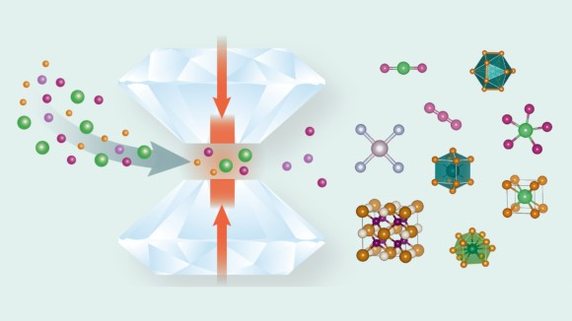
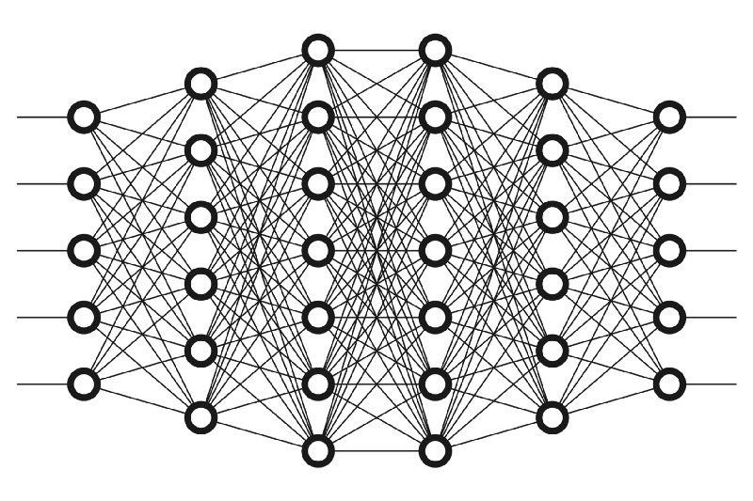
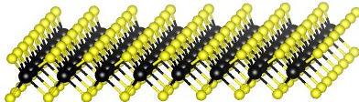
From New Chemistry to New Materials: Computational and Data-Driven Discovery
Austin Ellis
Department of Chemistry & Biochemistry, CSUN
May 1, 2026

Slide 2
Outline
Background
Quasi-atoms and chemical templates
Density Functional Theory and Crystal Structure Search
Machine Learning and Deep Neural Networks
Topic 1. Designing Tunable 2D Electrides
TMX₂ and the role of chemical templates.
Tunable 2D electrides through defect engineering
Topic 2. High Pressure Superconductivity
Superconductivity in Molecular Hydrides
Metallization in High-Pressure H₂ molecular crystals
Topic 3. Machine-learning Accelerated Materials Discovery
Chemical-template Guided Superhydride Discovery
Seitz-invariant ELF Prediction via a 3D CNN
Conclusions

Slide 3
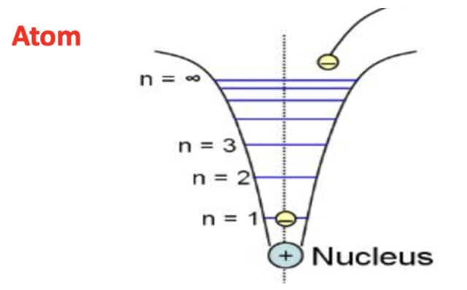
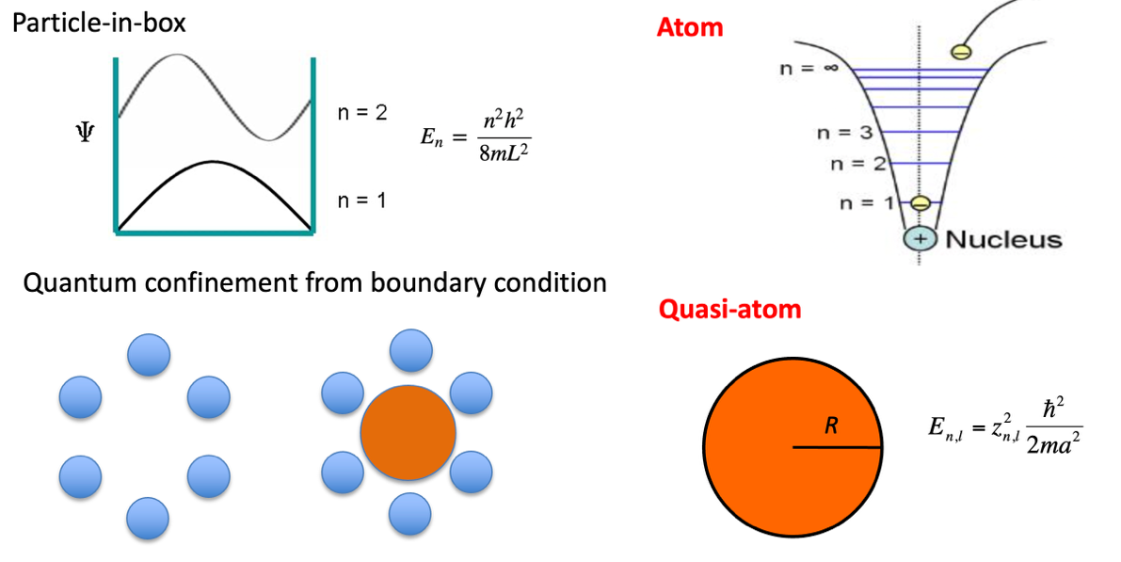
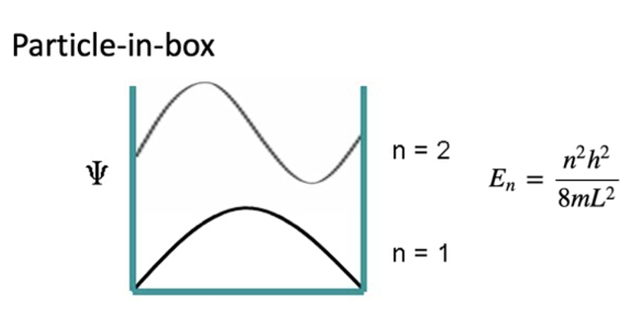


Quasi-atom: a missing concept in solid compounds
In solid compounds, all local orbitals are born equal.
Notes:
Is it important to have a nucleus to have a localized orbital? Orbital isn’t from nucleus, its from the confinement that results from the nucleus. Actually, even if we don’t have an atom, like in the textbook particle in a box problem, we still have discrete localized orbitals as a result of the confinement. In a solid, we have interstitial regions as a result of confinement from other atoms.

Slide 4
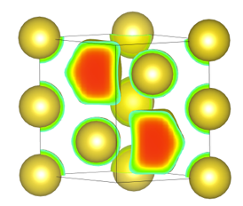
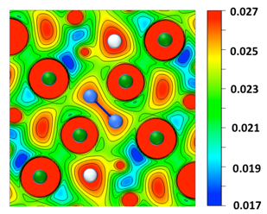
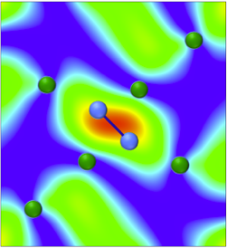
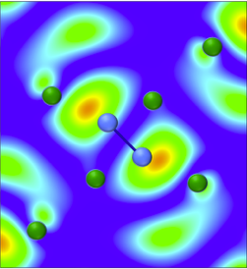
Quasi-atom Chemistry in materials
Quasi-anions
Quasi-molecules
Once occupied, interstitial states become chemically active sites
Overlap creates distinct motifs: quasi-anions, quasi-molecules, and bonding/anti-bonding quasi-atom pairs
Motifs help explain stability, band-gap behavior, and electron transport in dense materials
Na 200 GPa
Li 80 GPa
Quasi-atom bonds
Miao et al. Angew. Chem. 2016, 56, 972-975
Bonding
Anti-bonding
Notes:
Many phenomena are puzzling without this concept. But with it, very clear and easy to understand. Bonding STATE, not interaction

Slide 5
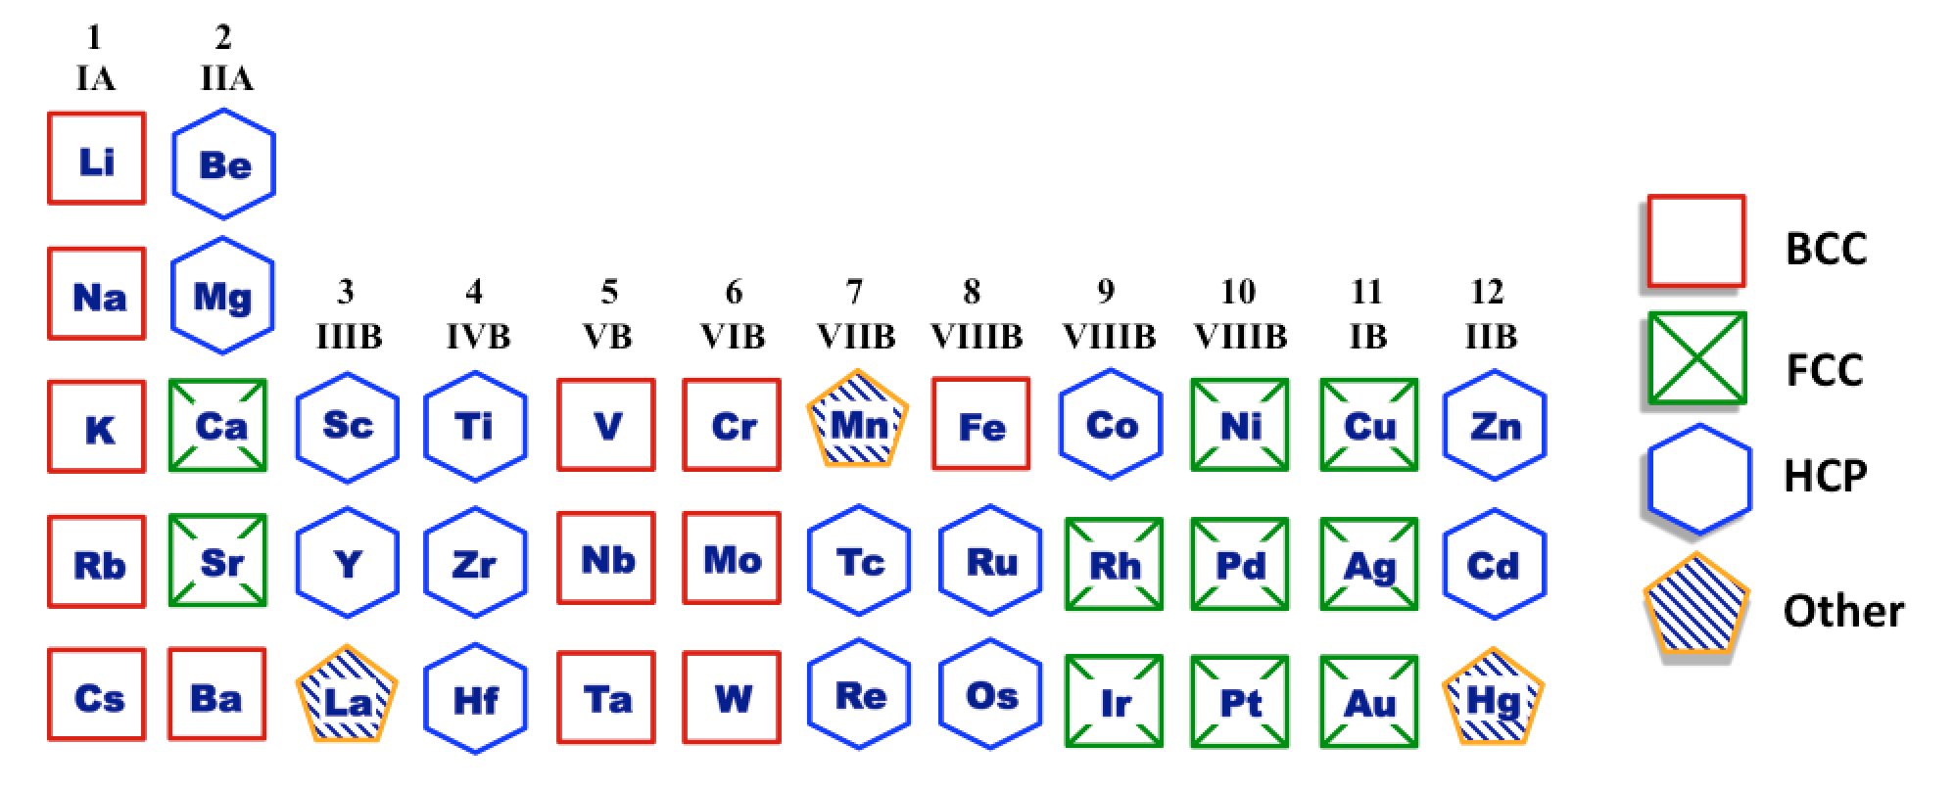
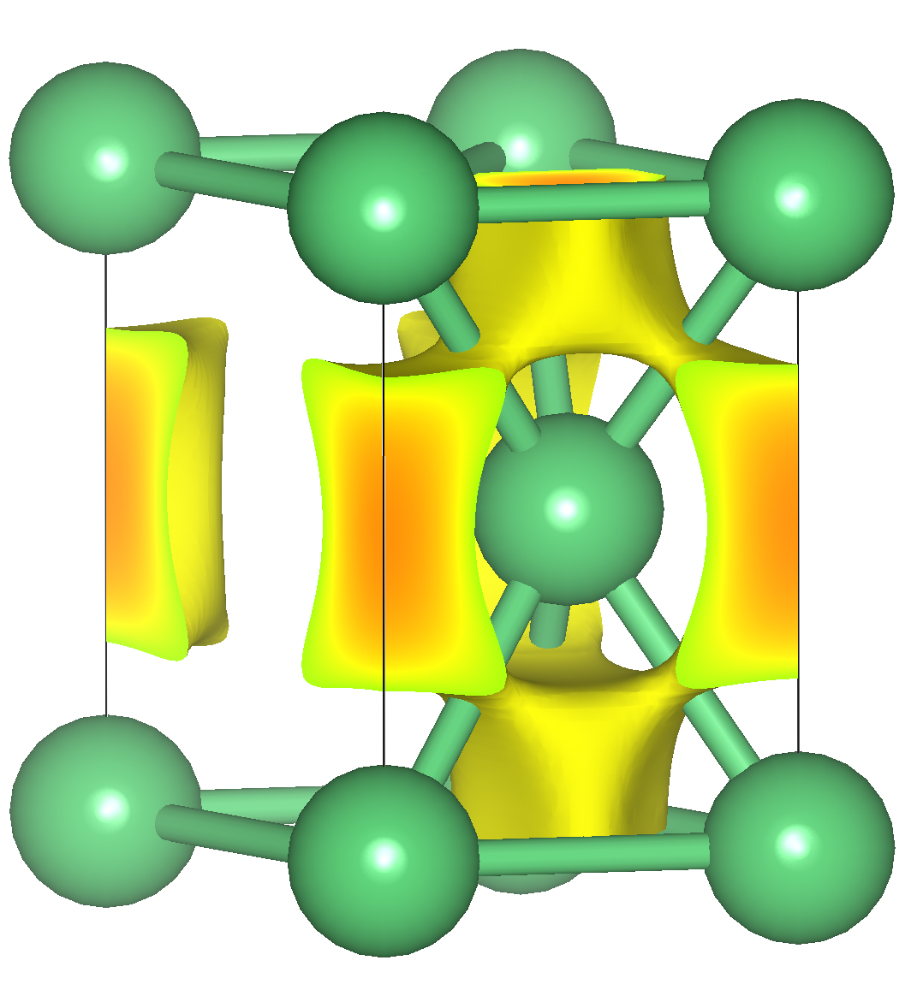
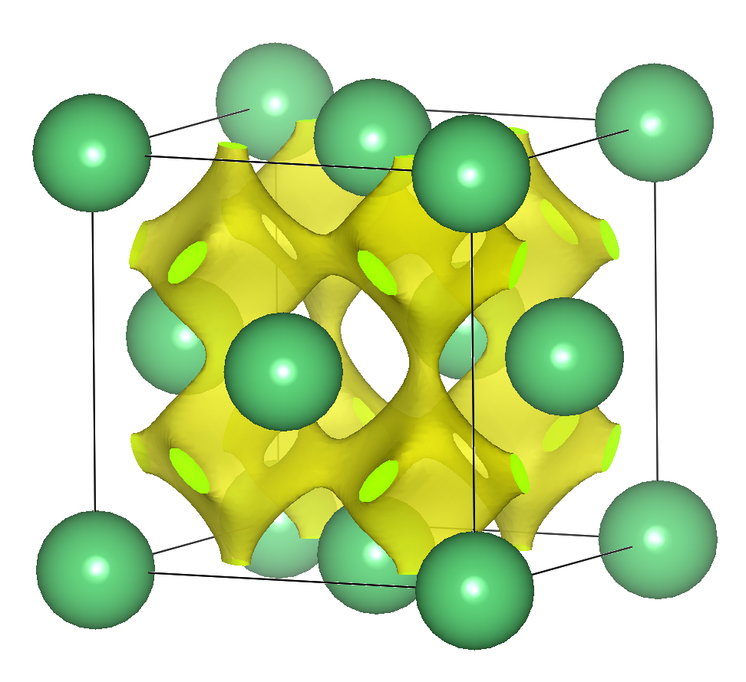
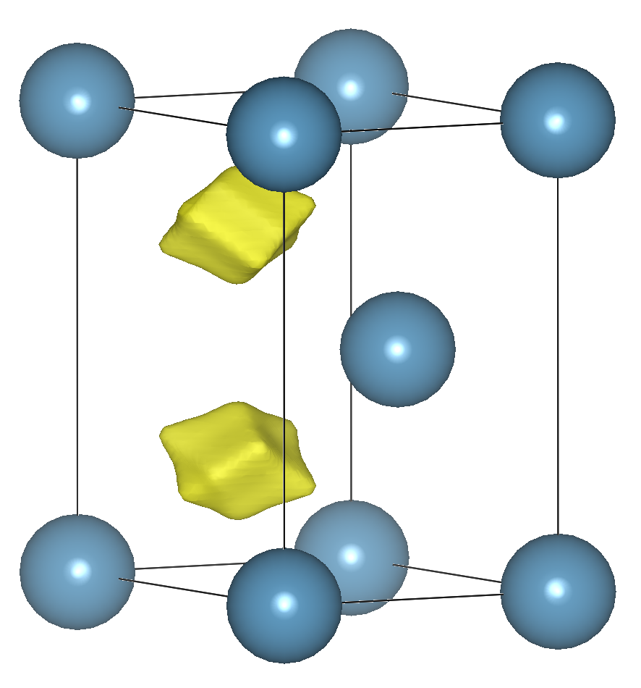
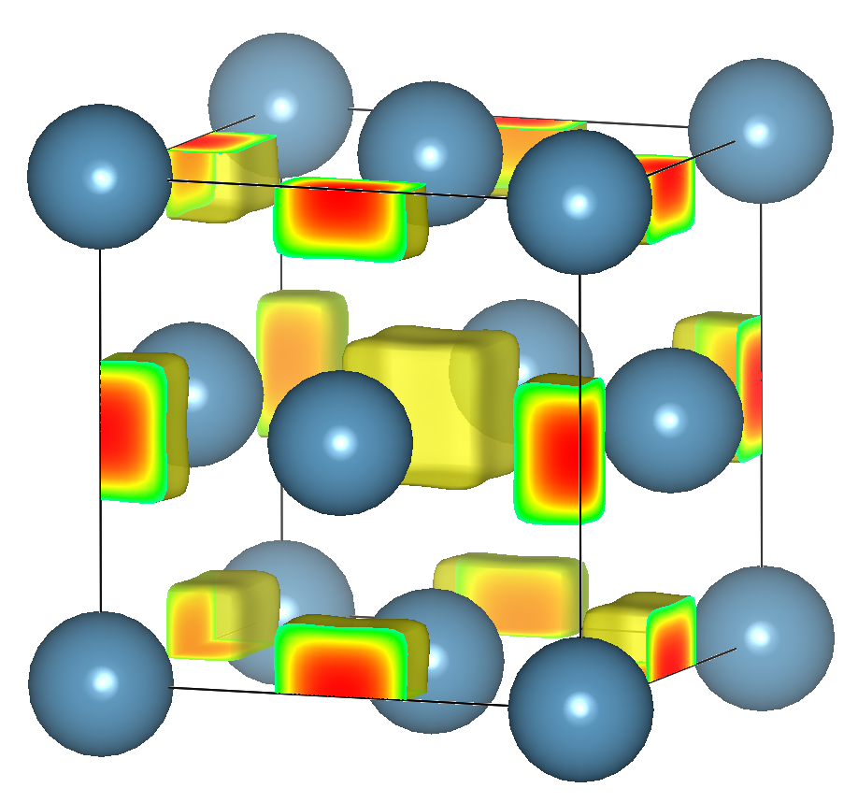
Quasi-atom bonds govern metal structures
The complex pattern of metal structures: a 100-year puzzle
Be HCP
Be FCC
Alkali metals adopt BCC
Alkaline metals adopt close packed except Ba (BCC)
Transition metals
Grps 3&4 HCP → Grps 5&6 BCC →
Grps 7&8 HCP → Grps 9,10,11 FCC → Grps 12 HCP
Ca HCP
Ca FCC
Sun & Miao, PNAS 2023
Notes:
100 year puzzle, first metal structure measured by XRD ~100 years ago. Luckily, this physics puzzle can be explained by chemistry. Why Be takes HCP and Ca takes FCC, its because electrons localize in different ways. In Be electron loxalization goes to tetrahedral site, and they form quasi-molecules. In Ca, they push to the octahedral site. In principle, many metals are atom-quasi atom compounds

Slide 6
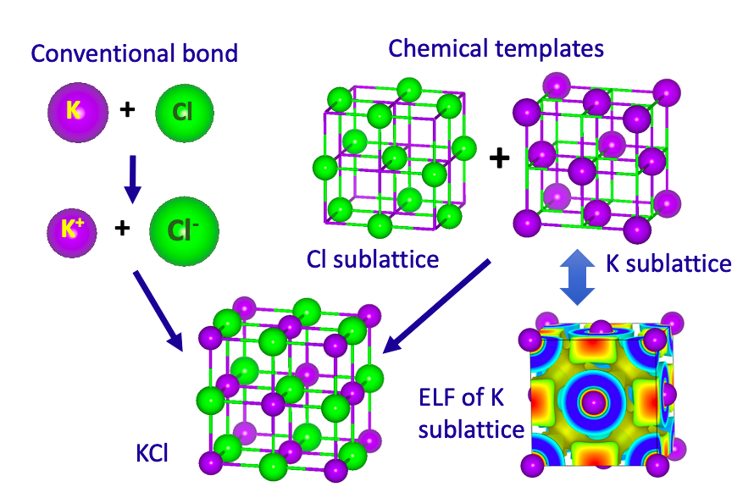


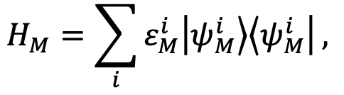
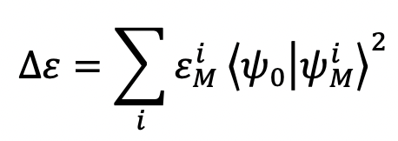
Chemical template theory
Sun & Miao, Chem 2023, 9, 443–459.
6

Slide 7
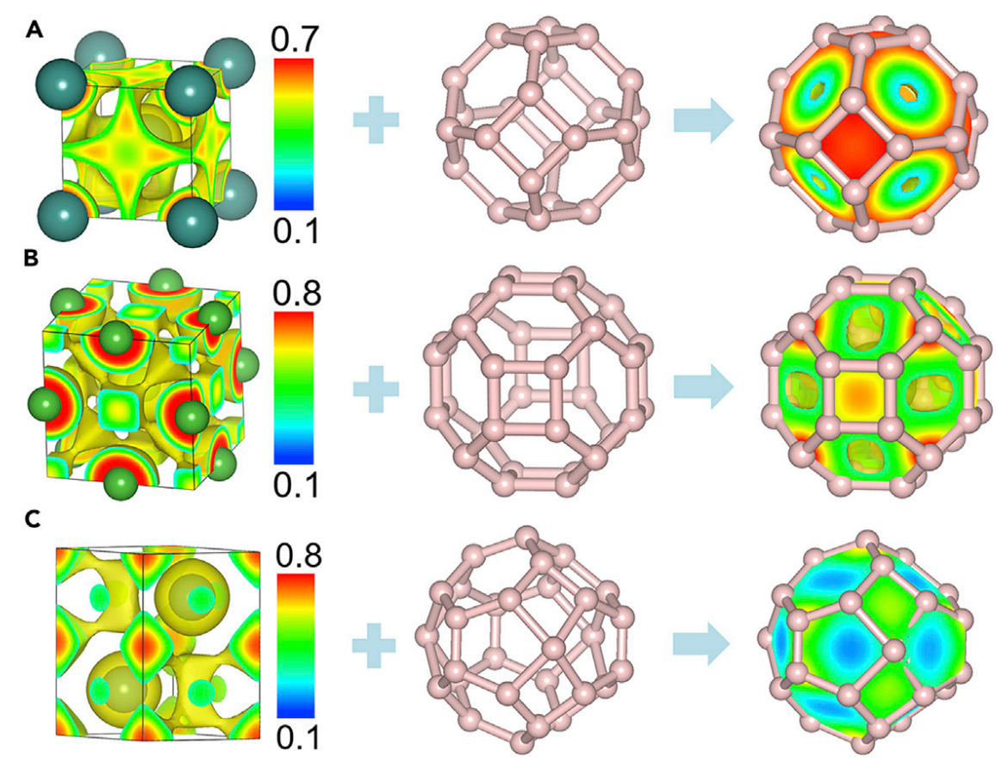
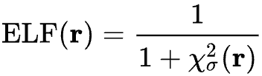
The ELF and the chemical templates in superhydrides
Electron localization function (ELF) compares local kinetic energy density to a homogeneous gas
High value = localized electrons
Low value = delocalization
Hydrogen atoms assemble in interstitial sites with high electron localization
Sun & Miao, Chem 2023, 9, 443–459.

Slide 8
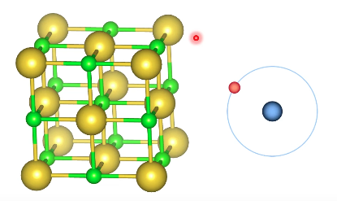
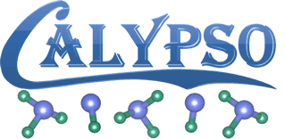
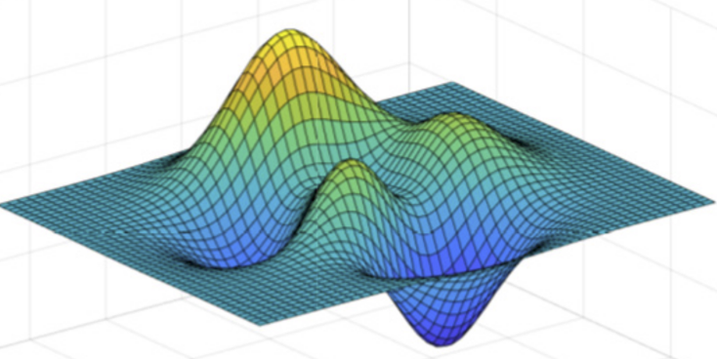

Density Functional Theory and Structure Search
First principles (QM)
Provides energies, forces, and electronic structure by solving for electron density
Allows relaxation of structures at target pressures via enthalpy comparisons
CALYPSO searches over lattice vectors and atomic positions to find low-enthalpy structures
Best candidates undergo further calculations and analysis
$$−{\frac{ℏ^{2}}{2m}}∇^{2}Ψ+VΨ=EΨ$$
Notes:
Can talk about general method development progress, DFT, CSS, to ML

Slide 9



Machine Learning vs Deep Learning
Machine Learning
Input
Extract Labels
Train
Predict
Traditional machine learning usually depends on hand-crafted descriptors extracted from inputs
Deep learning maps those representations automatically during training
Doors
Tires
$
Deep Learning
Input
Extract + Train
Predict
$

Slide 10
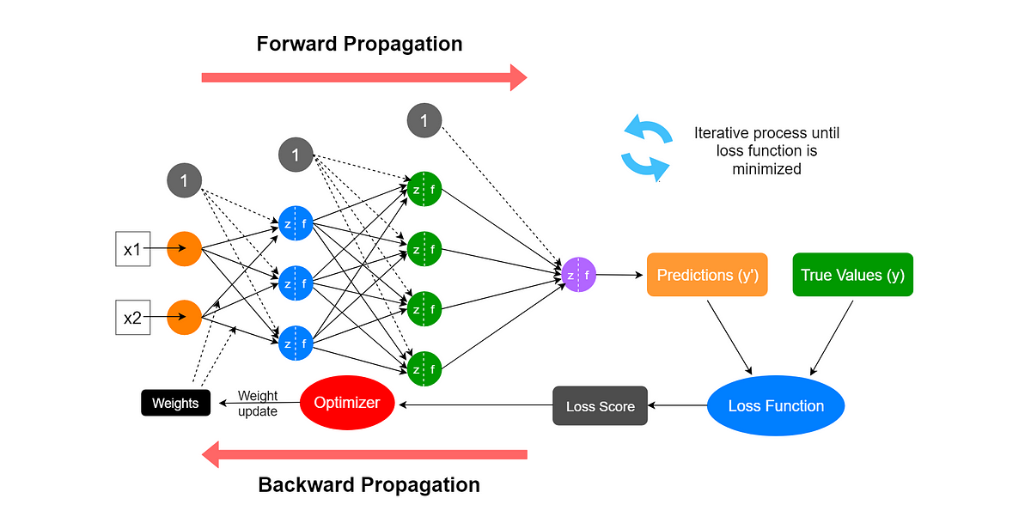
Anatomy of a neural network

Slide 11

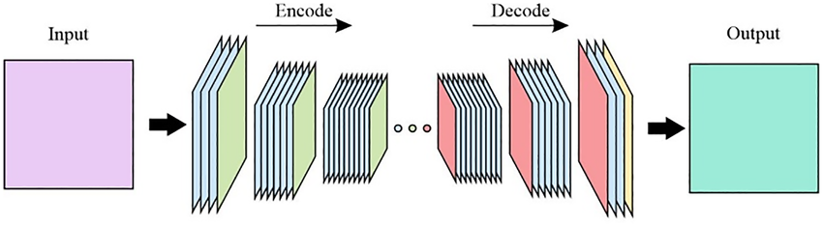
AutoGluon and Convolutional Neural Networks
Automated machine learning framework that trains, tunes, and combines multiple models
Useful for feature-based data where input is a set of descriptors
Convolutional neural networks (CNNs) learn spatial patterns from input
In encoder-decoder form, it can transform one spatial field to another
Notes:
Make a connection to slide 9

Slide 12

Topic 1: Designing tunable TMX₂ electrides
Sun, Ellis, et al. J. Phys. Chem. Lett. 2024, 15, 6174–6182.

Slide 13
TMX₂ and Chemical Templates

Slide 14
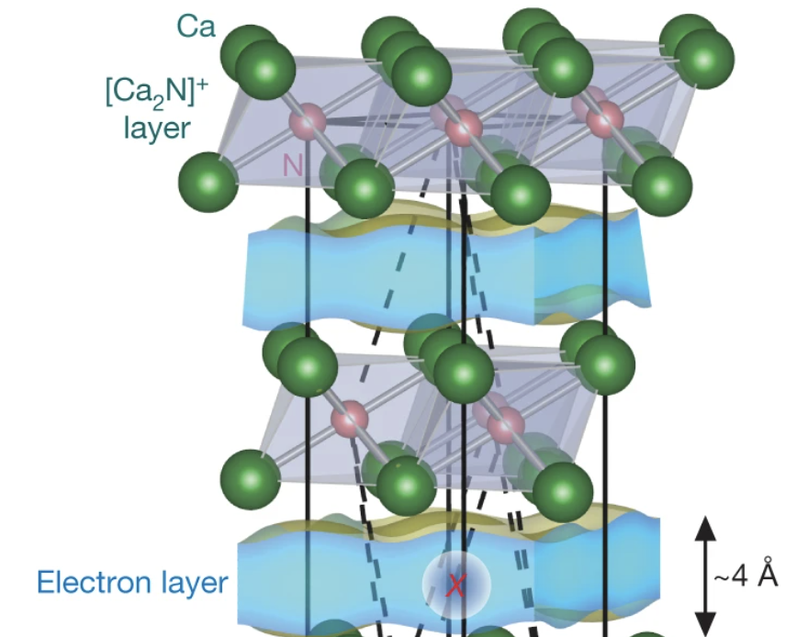
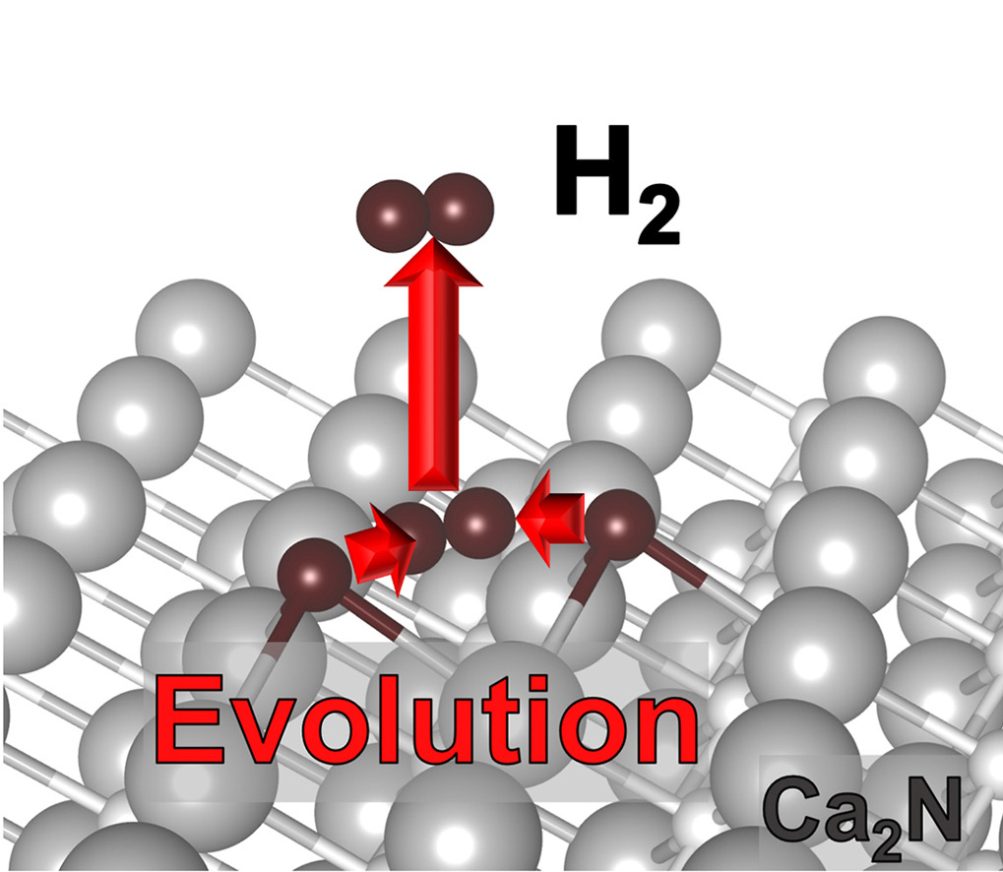
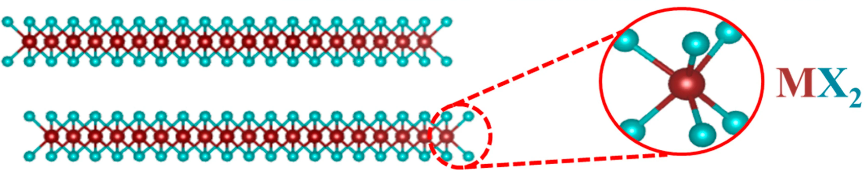

From Ca₂N Electrides to TMDC Catalysts
Electride: material where trapped electrons act as anions
Electrides enable strong H₂ activation
Major limitation: Ca₂N is highly sensitive to air and water
Solution: Can we engineer electride states in stable monolayer compounds like TMDCs?

Slide 15
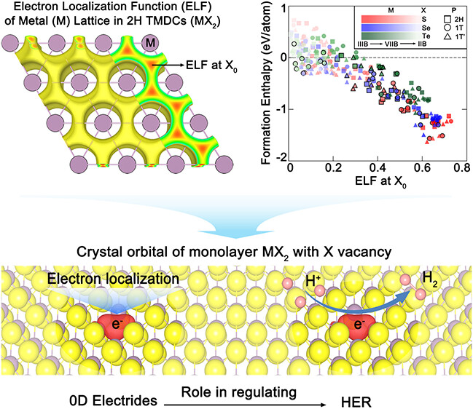
Chemical-template impacts TMDC stability
Metal sublattice retains distinct interstitial localization across 2H, 1T, and 1T’ phases
Larger ELF value at X₀ correlates with lower formation enthalpy

Slide 16
Tunable electrides through defect engineering

Slide 17

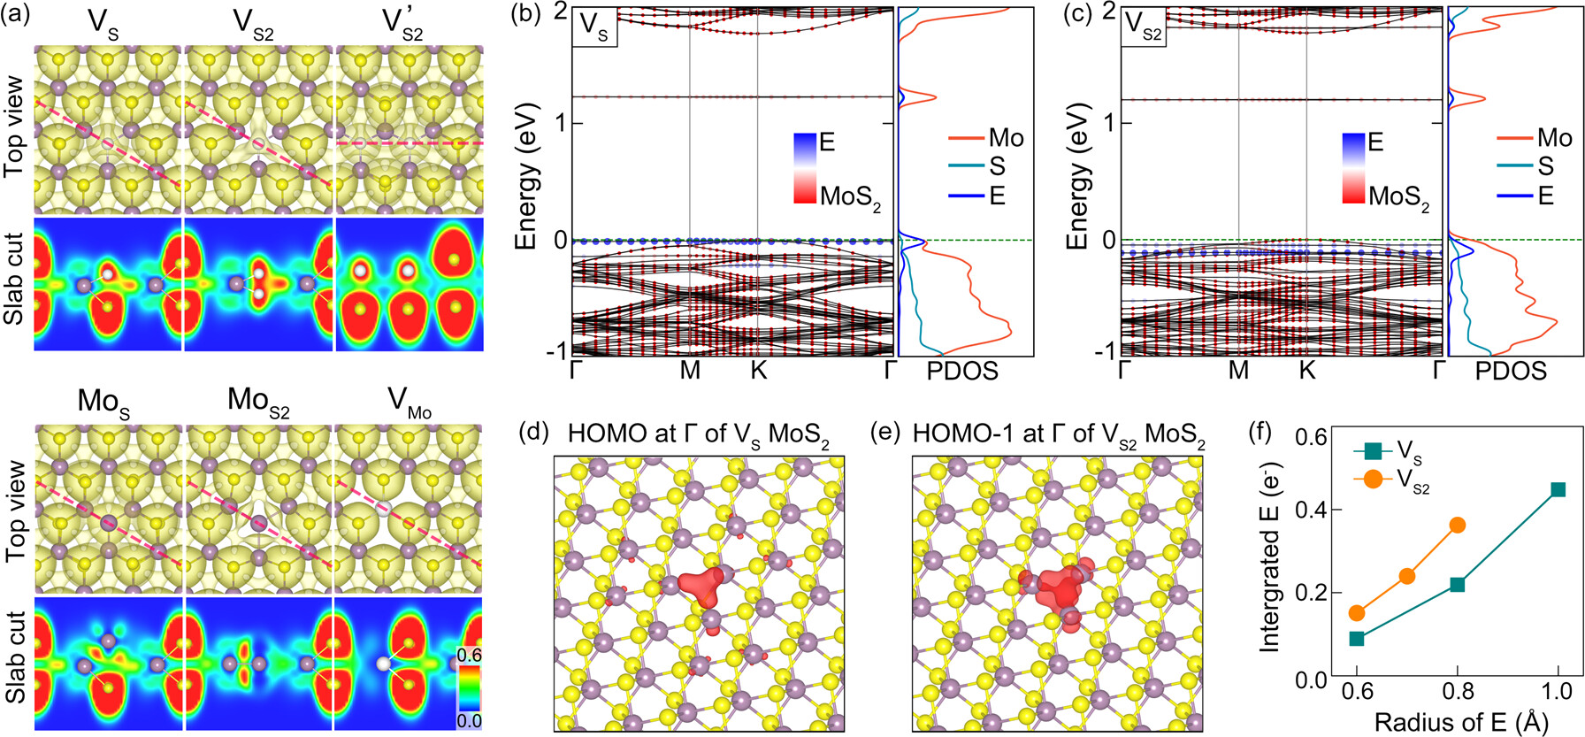
Vacancy engineering creates strong electrides
Only chalcogen vacancies generated interstitial electrons at the defect sites
Quasi-atom states in V_{S} and V_{S2-MoS2} contribute strongly near the top of the valence bands
Notes:
Explain why vacancy, you start with Mo lattice, once occupied by sulfur and forms MoS2, all electride features are gone. (maintains weak electride in center sites, but chemically useless). If we remove a non-metal atom, we might be able to restore the electride property. Vacancies are well-studied experimentally and there are ways to control their concentrations, so the electride property is tunable

Slide 18
Localized quasi-atom states at S vacancies
Frontier states in both V_{S} and V_{S2} are spatially localized at the vacancy-centered quasi-atom site
Localized electride states carry substantial charge at vacancy cite

Slide 19
Vacancy-induced electrides regulate H adsorption
Chalcogen vacancies trap excess electrons
Localized electrons behave as 0D electride states
Electride states tune H binding toward optimal HER
Notes:
Its better to show the catalytic process, show the actual catalytic process. Maybe put these at the end, supplemental?

Slide 20

Topic 2: High Pressure Superconductivity
Zhao, Ellis, et al. Adv. Funct. Mater. 2025, 35, 2415910.
Ellis, et al. J. Phys. Chem. Lett., submitted.

Slide 21
Superconductivity in molecular hydrides

Slide 22
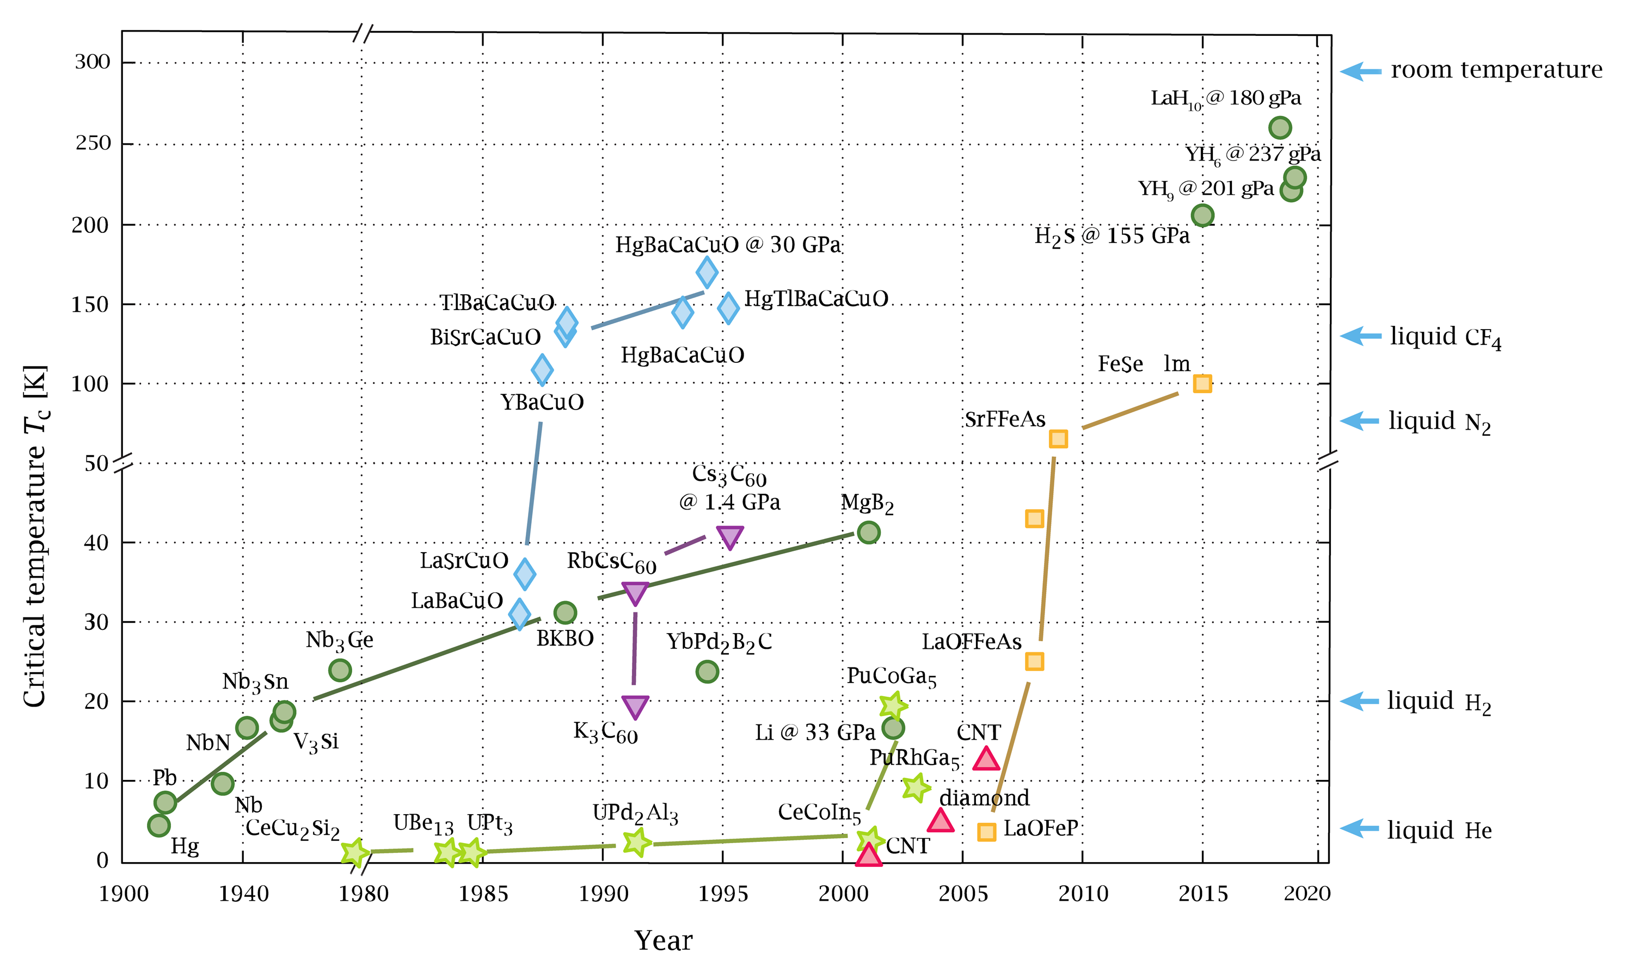
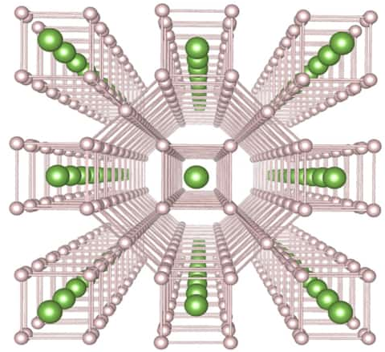
Superhydrides hold record superconducting T_{c}
High-pressure chemistry unveils unique material structures and unusual stoichiometries leading to discoveries of high T_{c} superhydrides
Notes:
Emphasize what superconuctors are, what superhyrides are. Normally we have stoichiometric structure of LaH3, but under pressure we can make structures like this (LaH10). Why do these structures form at all? Conventional understanding can’t explain it.
What are the goals? Room temperature superconductivity is one, very close, some claim it. Second goal, high Tc under lower more MODERATE pressure, ideally ambient pressure

Slide 23
The ELF predicts superhydride formation
Electron localization function (ELF) compares local kinetic energy density to a homogeneous gas
High value = localized electrons
Low value = delocalization
Hydrogen atoms assemble in interstitial sites with high electron localization
Sun & Miao, Chem 2023, 9, 443–459.

Slide 24
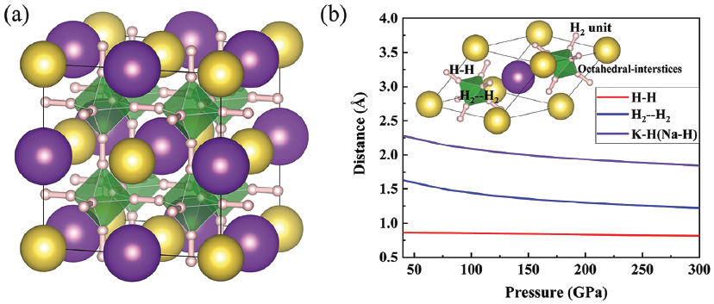
Structure and bonding in NaKH₁₂
Electron localization at the interstitial sites surrounded by 6 H₂ molecules

Slide 25
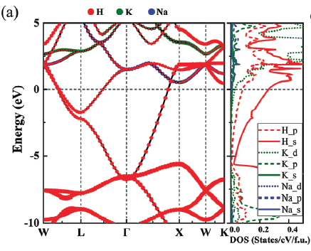
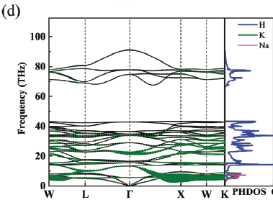

Origin of high T_{c} Superconductivity
Predicted T_{c} of 245K at 60 GPa
Higher density of H states near E _{F}
strong electron-phonon coupling

Slide 26

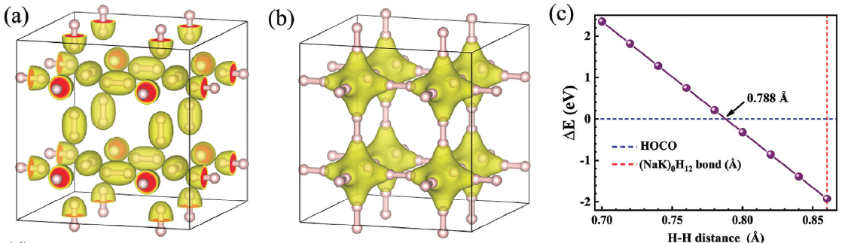
Elongated H₂ bonds create interstitial electronic state
Conventional H₂ bonding state
Interstitial orbital between H₂ units
Interstitial state becomes occupied above ~0.79 Å

Slide 27
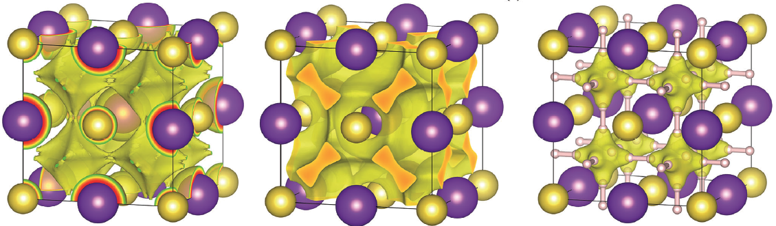
NaK metal sublattice acts as a chemical template
ELF of NaK metal sublattice shows strong interstitial localization
Occupied orbital of sublattice is centered at the same interstitial sites
Orbital persists in full NaKH₁₂ linking neighboring H₂ molecules

Slide 28
Metallization in high pressure H₂ molecular crystals
Notes:
transition: what if we completely remove the metals? Pure hydrogen is also an important system, people tried to metallize hydrogen system but it required too much pressure. People found that the metallization doesn’t require metallization of the H2 molecules. Maintains molecular structure at onset of metallization

Slide 29
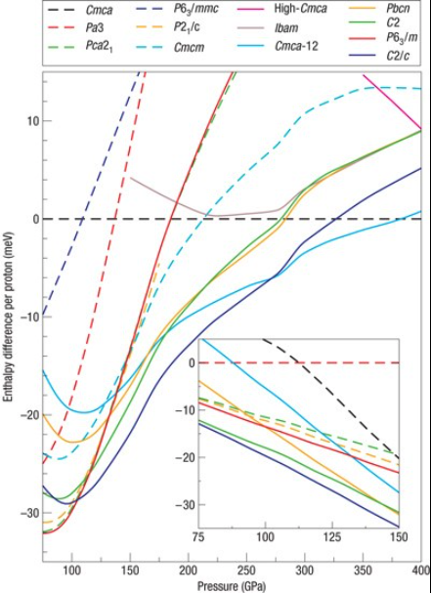
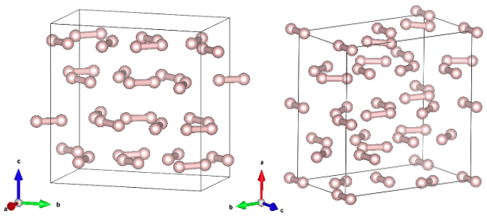
Competing phases for dense H₂ under pressure
B2n
Ama2
Many proposed phases are very close in enthalpy, assigning a “correct” structure is difficult
Representative structures chosen due to agreement with experimental results
Pickard & Needs, Nat. Phys. 2007, 3, 473–476.

Slide 30
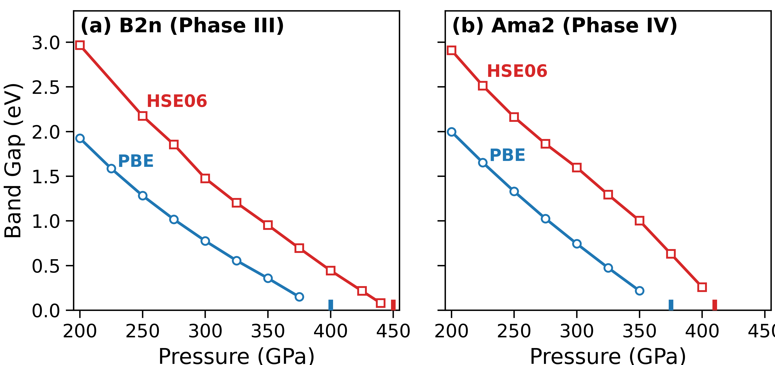

Pressure-driven gap closure in molecular hydrogen
PBE is known to underestimate energy gaps
HSE06 functional is more consistent with experimental metallic transition near 425-500GPa
PBE – standard DFT functional that approximates electron interactions
HSE06 – more accurate, but more expensive functional (exact exchange)

Slide 31
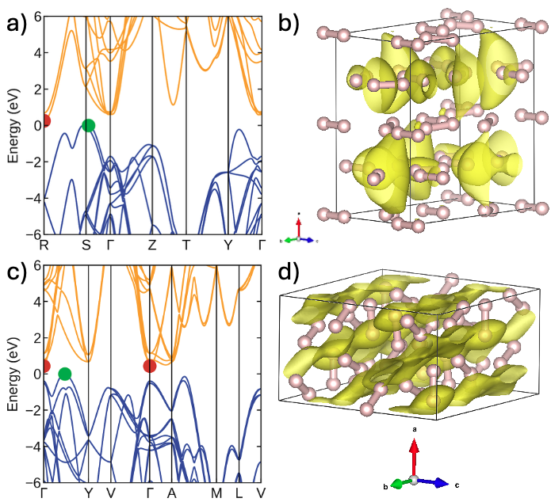

Interstitial band-edge states drive metallization
In B2n, conduction band minimum forms lobes that bridge neighboring molecules through dense 3D lattice
B2n 425 GPa
In Ama2, layered geometry channels charge into sheet-like pathways between molecular layers
Ama2 400 GPa

Slide 32

Topic 3: Machine learning assisted materials discovery
Sun, Ellis, et al. JACS 2025, 147, 40407–40419.
Ellis, Miao. PRX Intelligence, submitted.
Notes:
Cover figure, put a more relevant figure?

Slide 33
Chemical-template guided superhydride discovery

Slide 34
The ELF predicts superhydride formation
Electron localization function (ELF) compares local kinetic energy density to a homogeneous gas
High value = localized electrons
Low value = delocalization
Hydrogen atoms assemble in interstitial sites with high electron localization
Sun & Miao, Chem 2023, 9, 443–459.

Slide 35
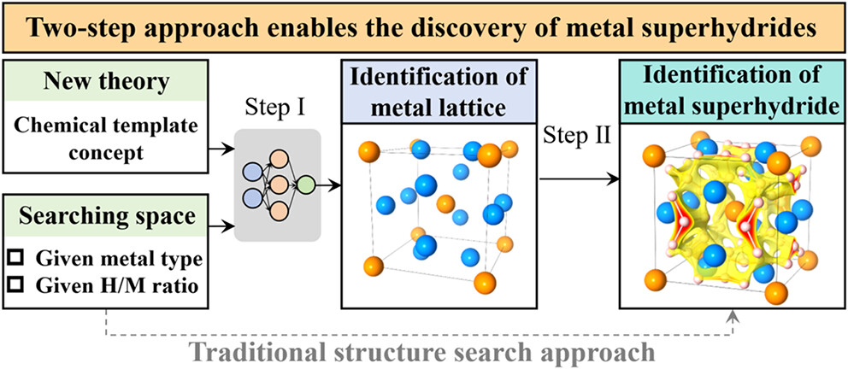
Chemical template-based discovery workflow
Using the chemical template theory and corresponding 2-step approach greatly reduces the search space and makes superhydride discovery more efficient.

Slide 36
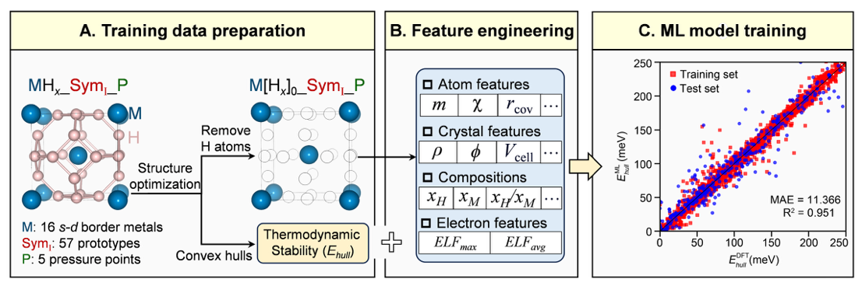
Predicting formation energy from metal templates
Step 1. training set preparation (DFT)
Step 2. feature engineering
Step 3. ML model training
Notes:
Show autogluon logo again

Slide 37
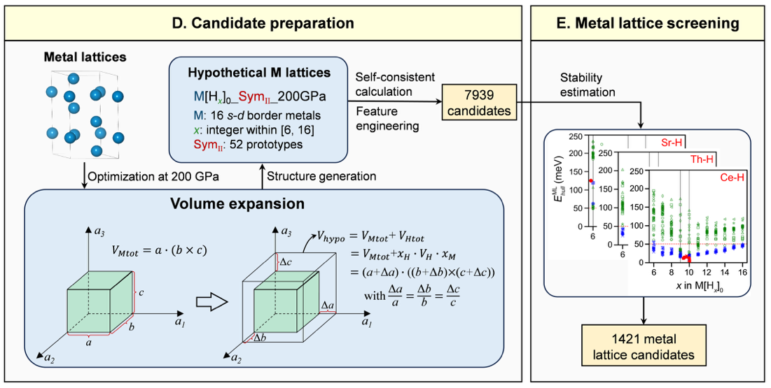
Screening metal lattices for promising candidates
Step 4. metal lattice candidates
Step 5. metal lattice screening

Slide 38
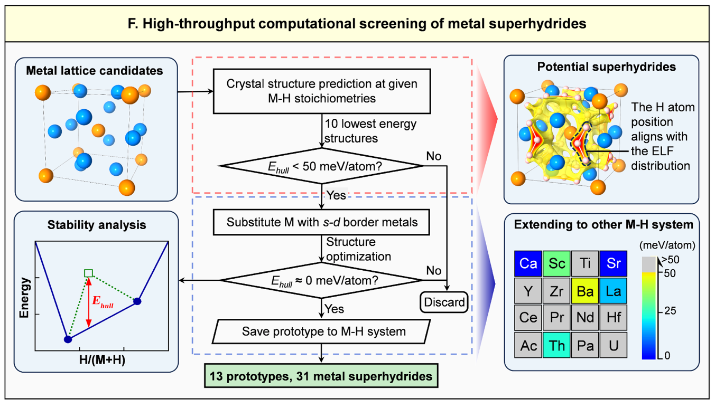
Predicting new superhydride structures
Step 6. Search MH_{n}
Workflow based on the chemical template
New structures will be transferred to other MH_{n} and SCC
Allows us to search complex MH_{n} with very large cells
Notes:
Now we can search more complex structures with larger cells in a fraction of the time

Slide 39

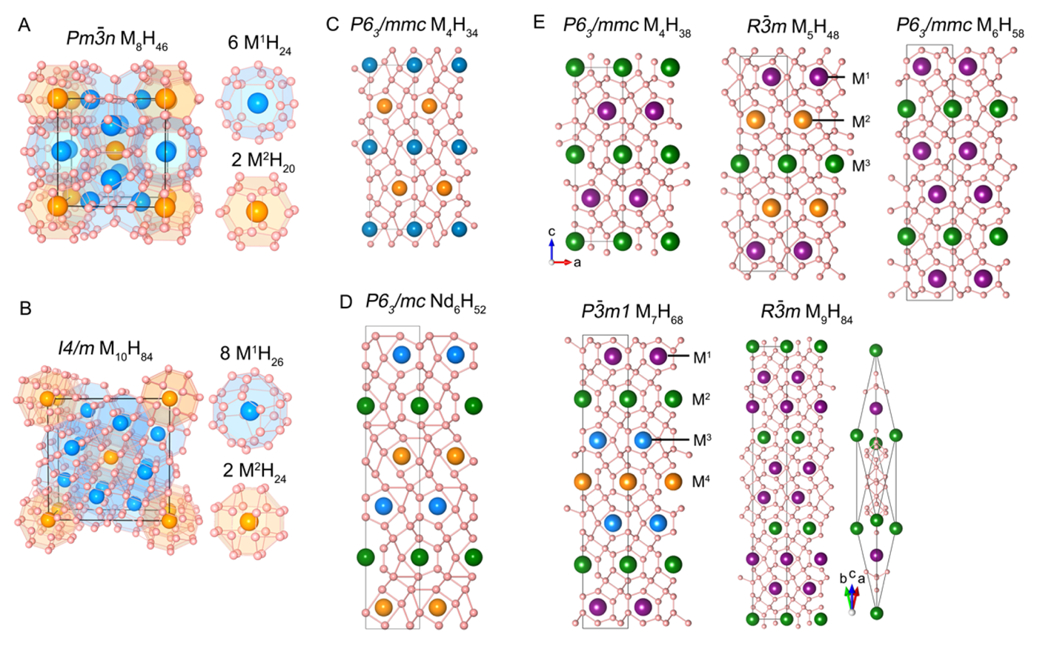
Newly identified metal superhydrides
Many new phases appear at non-integer H/M ratios
Newly identified phases have large primitive cells that would’ve been nearly impossible to search with traditional methods

Slide 40

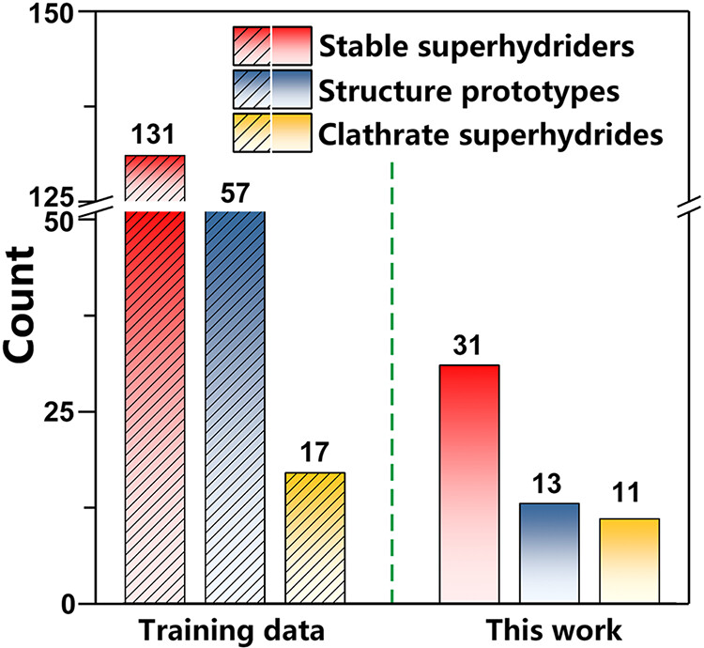
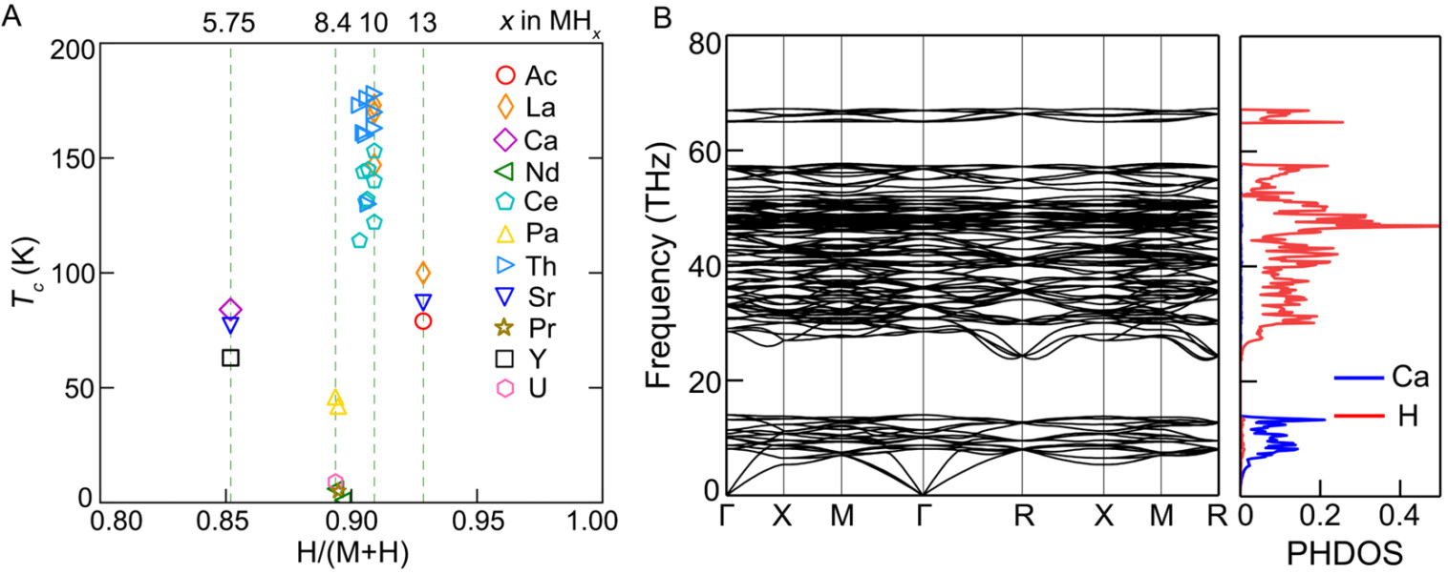
Superconductivity of novel superhydrides
Ca₈H₄₆
Estimated T_{c} values suggest that many of the newly discovered superhydrides are strong high T_{c} candidates, with 19 above 100 K
Superconductivity is driven mainly by H-dominated high-frequency phonons
Workflow identified 31 new stable metal superhydrides and 13 new structural prototypes

Slide 41
Seitz-invariant ELF prediction via 3D CNN

Slide 42

The ELF can be expensive to calculate
First Principles (QM)
Machine Learning (ML)
$$−{\frac{ℏ^{2}}{2m}}∇^{2}Ψ+VΨ=EΨ$$
Solution: We can treat the ELF as a 3D image and train a model to predict it directly
Problem: How do we represent our structure?
The time required to run a quantum mechanics-based calculation scales cubically with electron count (N)

Slide 43
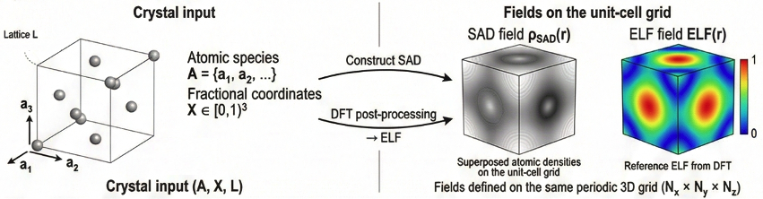
Crystal structure representation
SAD is the electron density obtained by freezing atomic charge density at each atom center without allowing their electron clouds to hybridize or relax into bonded states
Since the SAD and ELF have the same grid size, the problem is now an image transformation

Slide 44
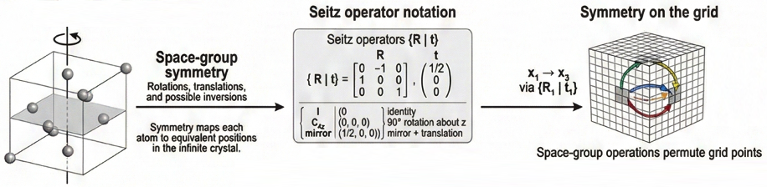
Making the model Seitz-Invariant
Seitz symmetry – Standard notation system for describing the symmetry operations of crystal structures in 3D space groups
Invariance – Property that guarantees the model makes the same prediction even if the crystal structure is rotated or translated according to its symmetry group

Slide 45






Architecture for a symmetry-aware image transform
+

Slide 46




Physics-aware loss function
Kendall Loss: An adaptive weighting scheme that automatically learns how to balance the voxel, gradient, and histogram objectives during training, eliminating the need to manually tune loss weights.

Slide 47


Electron localization function prediction
Model tested on subset of metal lattices
Maxima most relevant to prediction of superhydride structures

Slide 48

Conclusions
Quasi-atom states and chemical templates provide a framework for understanding the formation mechanism and structure preference of many compounds
In TMX₂ monolayers, chemical templates and vacancies create tunable electride behavior and influence H adsorption
Interstitial states help explain strong superconductivity in molecular hydrogen and pressure driven metallization of H₂
Template-guided machine learning accelerates discovery, enabling efficient screening of superhydrides and rapid ELF prediction

Slide 49




Future work

Slide 50






Acknowledgements
Dr. Miao
Dr. Teprovich
Dr. Lau
Dr. Sun
Dr. Pandit
Samantha Ellis
Friends at CSUN
Department of Chemistry and Biochemistry
College of Science and Math

Slide 51


2H-TMDCs Exhibits Weak Electride Character
Electride character is a broader materials trend, not an isolated feature of MoS₂
ELF reveals interstitial localization at centers of Mo triangles

Slide 52



Chemical templates that assemble superhydrides
Interstitial electrons in metal lattices naturally occupy H lattice orbitals
How can we use this phenomenon to predict new superhydrides?

Slide 53

Interstitial charge grows before metallization
Charge density difference plots show charge redistribution with increasing pressure
Yellow = charge density lost
Cyan = charge density gained
Metallization preceded by redistribution of charge to intermolecular space, not molecular dissociation

