Slide 1

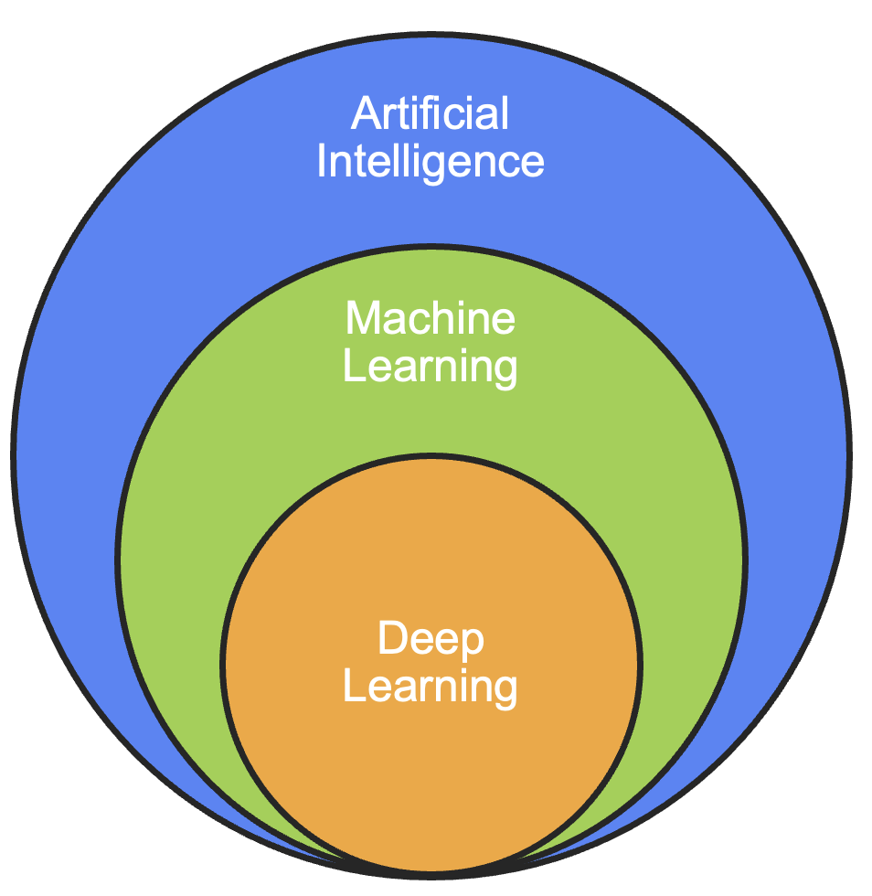
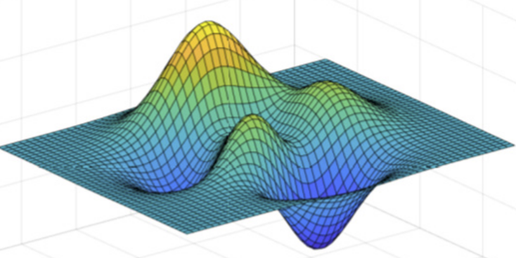
Advancements in Machine Learned Interatomic Potentials
Austin Ellis
Department of Chemistry and Biochemistry, CSUN
Literature Seminar, March 28th, 2025

Slide 2
Outline
Background
  Interatomic Potentials: History and Trends
  Machine Learning: Traditional vs. Deep Learning
Machine Learned Interatomic Potentials
  ACE: A Supervised Learning Approach
  MACE: A Deep Learning Modification
MACE Applications in Chemistry
  2D materials edges and defects – a story of success
  Hydrogen under pressure – a story of failure
Summary and outlook

Slide 3
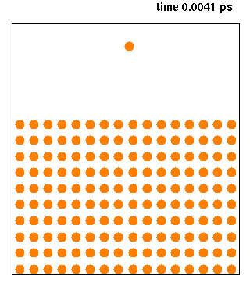
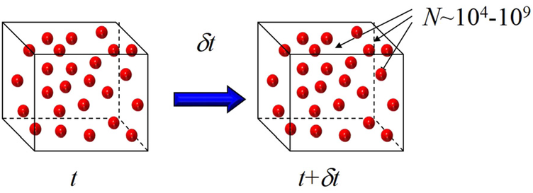
Quantum chemistry: limit and beyond
Main issue: computational costs too high!
Space scale – 1K to 1M atoms
Time scale – picosecond to capture reactions
Scaling with electron count (N) means only small systems are possible
Interatomic potentials let us model the way a system changes over time with only energies and forces!

Slide 4
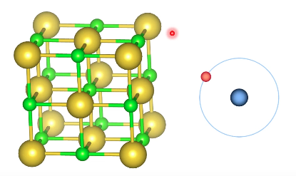
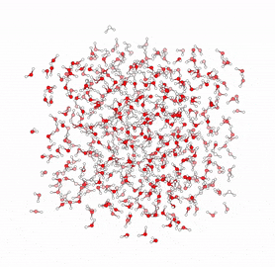
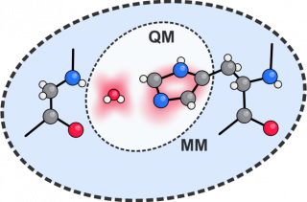
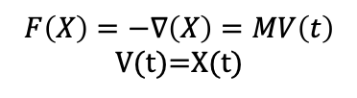

Types of simulations
First Principles (QM)
QM/MM
Molecular Mechanics (MM)
$$F\left(X\right)=−∇\left(X\right)=MV\left(t\right)$$
V(t)=X(t)
$$−{\frac{ℏ^{2}}{2m}}∇^{2}Ψ+VΨ=EΨ$$
Hybrid
Need accurate
Interatomic Potentials
Accuracy
Scalability

Slide 5
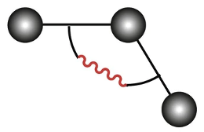

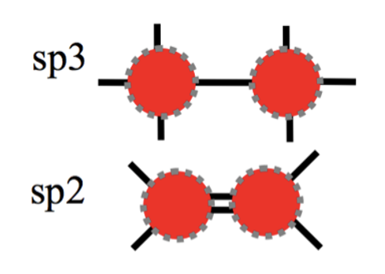
Developments of Interatomic potentials
3-body
Pairwise
Bonding
A major challenge of Interatomic Potentials is to capture Chemistry

Slide 6
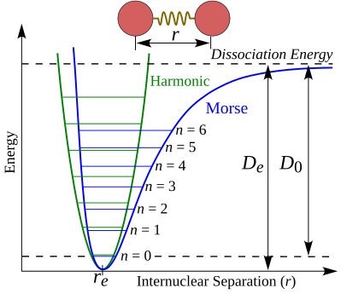
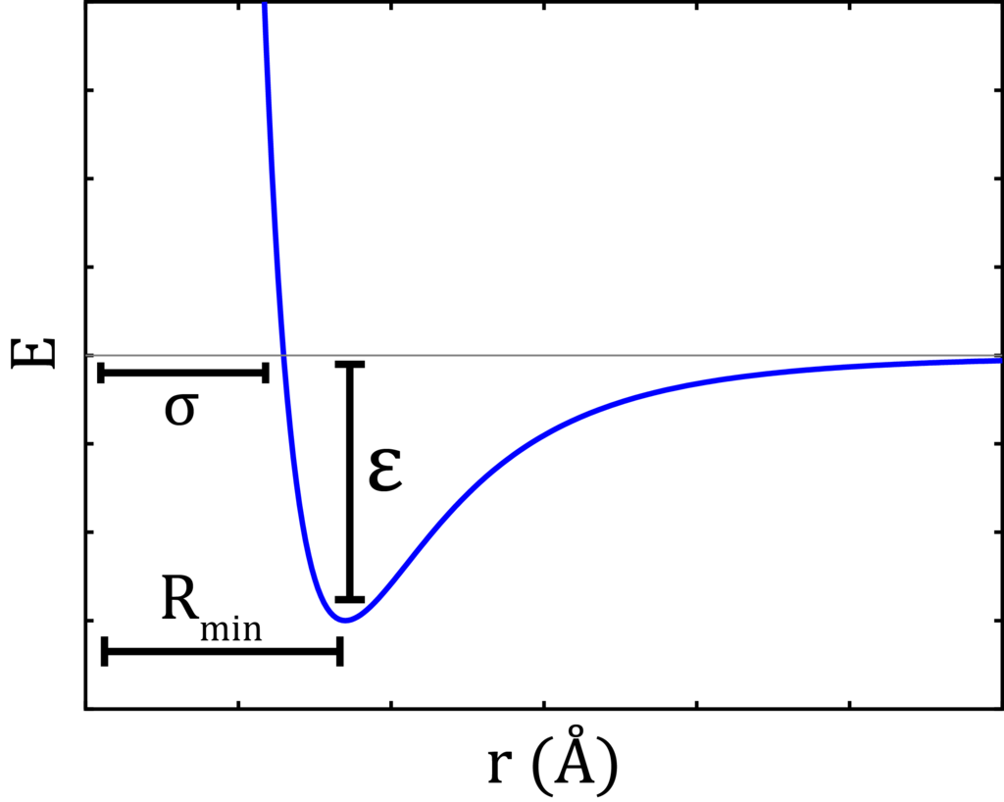




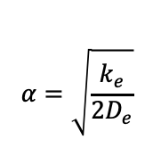
Semi-empirical diatomic potentials
Lennard-Jones Potential (1924)
Morse Potential (1929)
$$α=\sqrt{\frac{k_{e}}{{2D}_{e}}}$$
V$\left(r\right)={D_{e}(1−e^{−α\left(r−r_{e}\right)})}^{2}$
Pauli repulsion: $\frac{1}{r^{12}}$
Dispersive forces: $\frac{1}{r^{6}}$
$E\left(r\right)=4$∊[${(\frac{σ}{r})}^{12}$- ${(\frac{σ}{r})}^{6}$]
Can be found in many textbooks

Slide 7
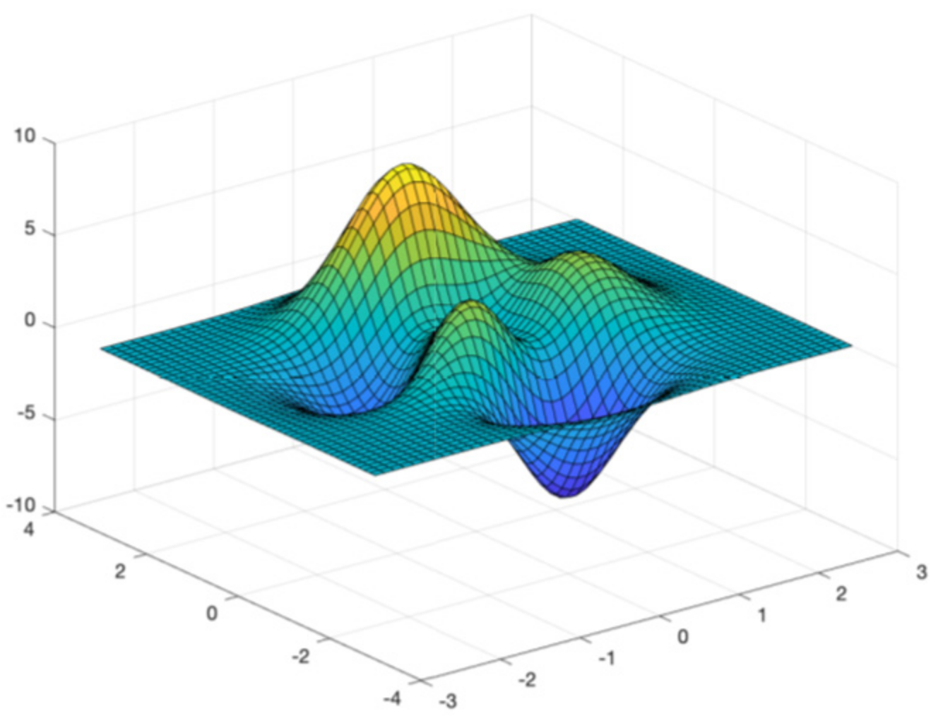
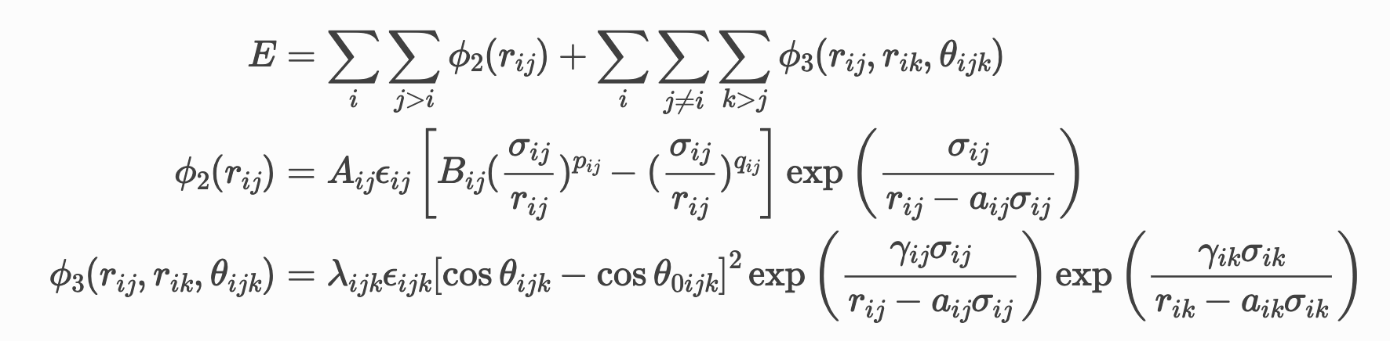
Beyond pair-wise interatomic potentials
Stillinger-Weber (1985)
Stillinger-Weber (SW) is a three-body potential adding angular dependence, improving pairwise models for covalent materials.
More accurate than pair potentials for materials where bond angles determine structure and properties (like the Si system was developed for)
Stillinger et al. Phys. Rev. B (1985)

Slide 8
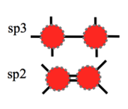
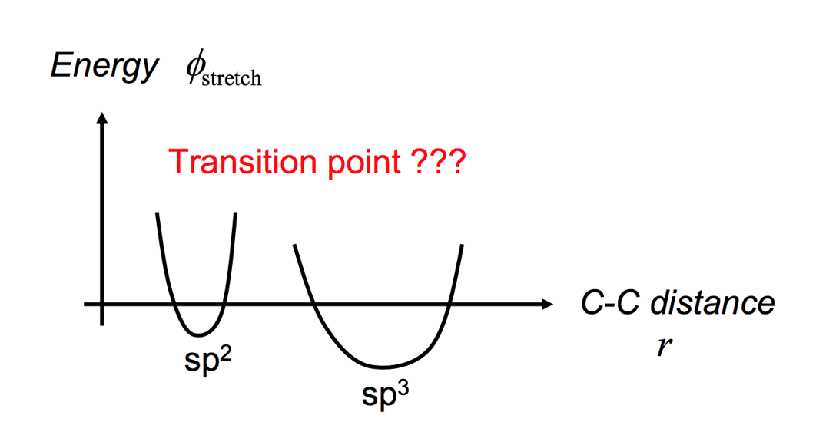
Capturing chemistry by interatomic potentials
Reactive Force Field (ReaxFF)
Pairwise potentials can’t predict the breaking and forming of bonds
Bond order based force field developed at CalTech by Van Duin and Goddard (2001)
Bond length → Bond order → Energy
van Duin et al. J. Phys. Chem. A (2001)

Slide 9
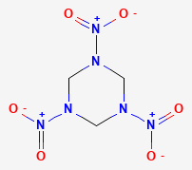
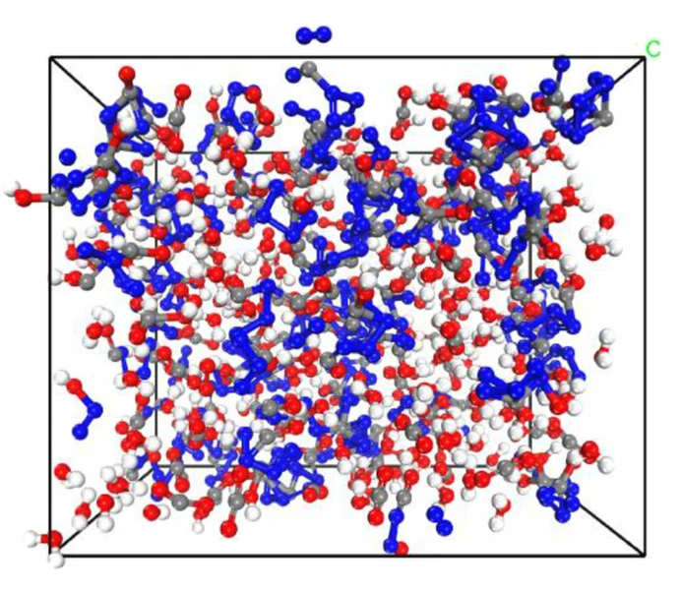
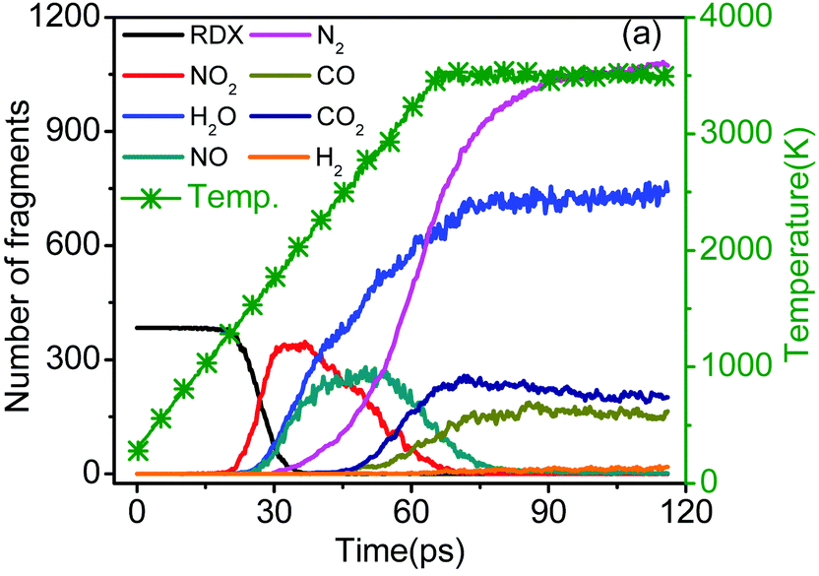
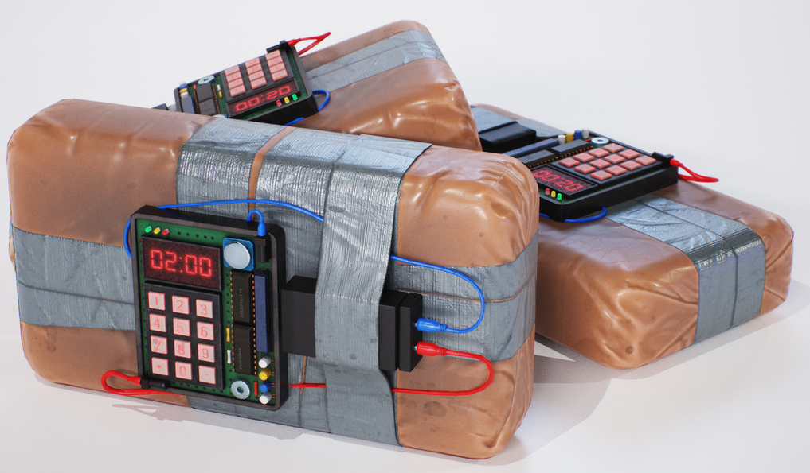


ReaxFF simulating RDX decomposition
Capturing chemical reactions
Wang et al. J. Phys. Chem. C (2017)

Slide 10
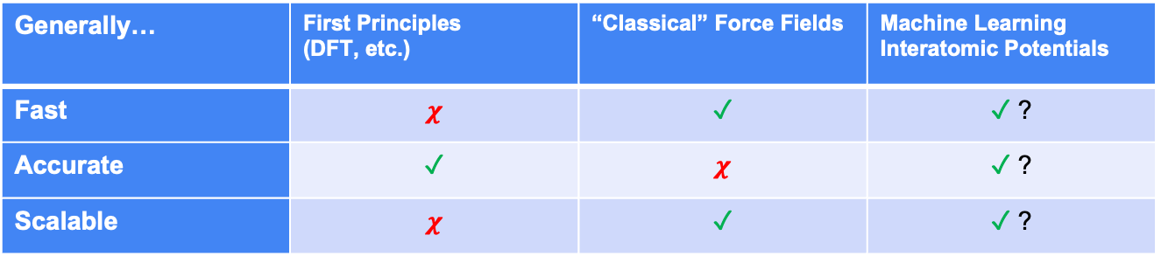
Three birds, one stone
Generally… | First Principles (DFT, etc.) | “Classical” Force Fields | Machine Learning Interatomic Potentials
Fast | $$χ$$ | $$\text{✓}$$ | $\text{✓}$ ?
Accurate | $$\text{✓}$$ | $$χ$$ | $\text{✓}$ ?
Scalable | $$χ$$ | $$\text{✓}$$ | $\text{✓}$ ?
Features
Energy
How does it work?

Slide 11
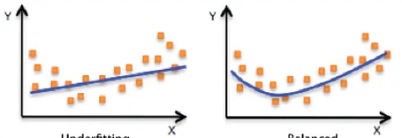
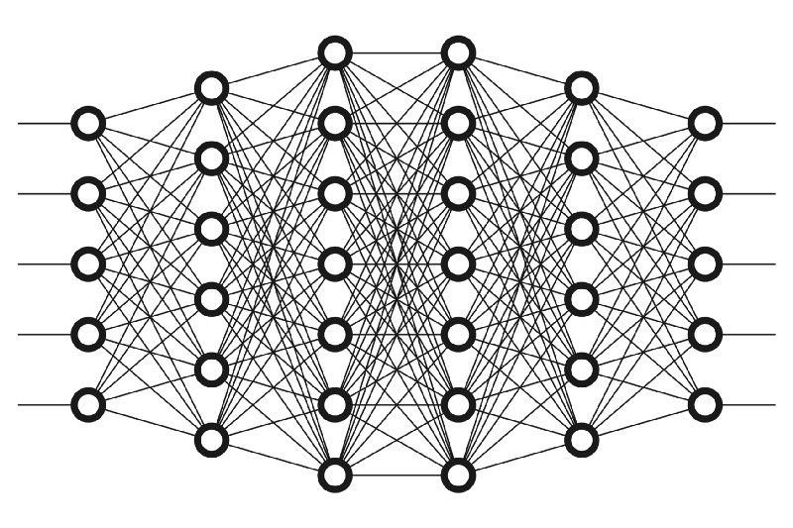
Paradigm shift: Data Driven Potentials
3-body
Supervised Learning
Pairwise
Bonding
Deep Learning

Slide 12



ML advancements: old versus deep
Machine learning methods
Machine Learning
Artificial Intelligence
Machine Learning
Deep Learning
Input
Extract Labels
Train
Predict
Doors
Tires
$
Deep Learning
Input
Extract + Train
Predict
$

Slide 13
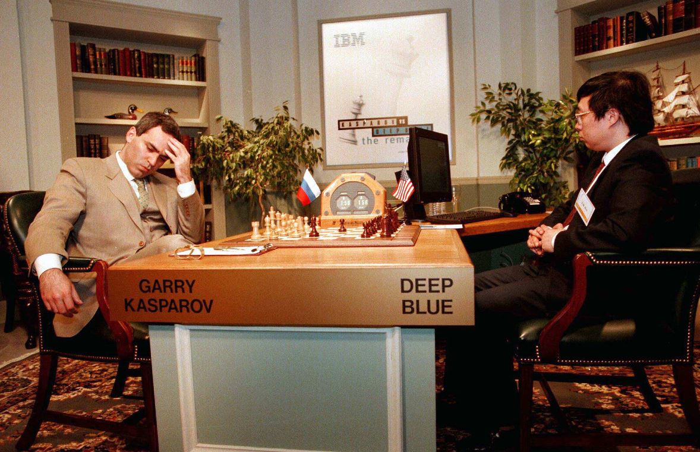
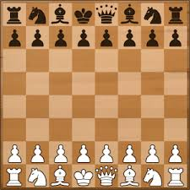
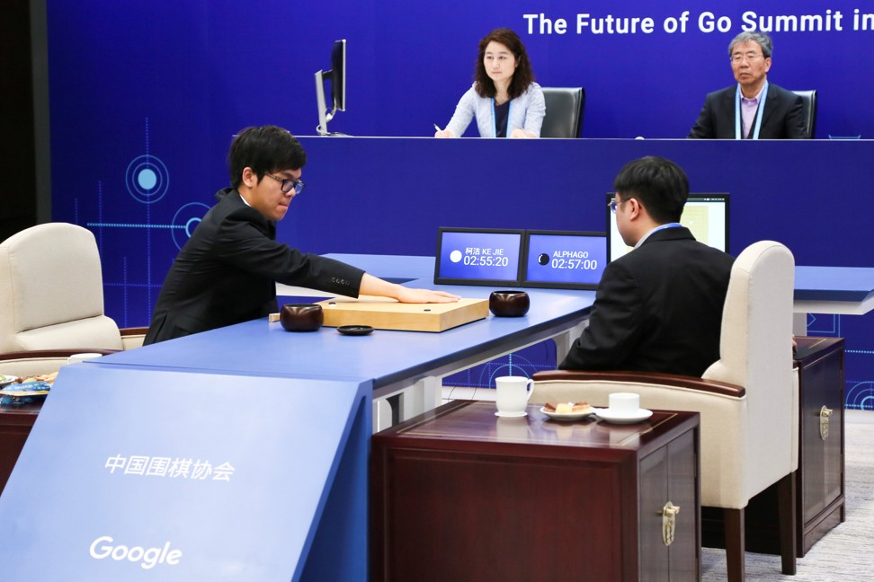
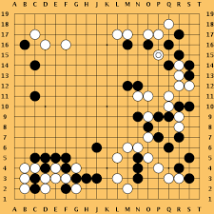
ML history: old versus deep
Human vs. Computer
1996
2016

Slide 14
Varying Complexities
ML: from chess to GO …
Elements
32,
6
2
<361,
Structures
2D, 8×8
2D, 19×19
2.08×10¹⁷⁰
Rules
moderate
simple

Slide 15
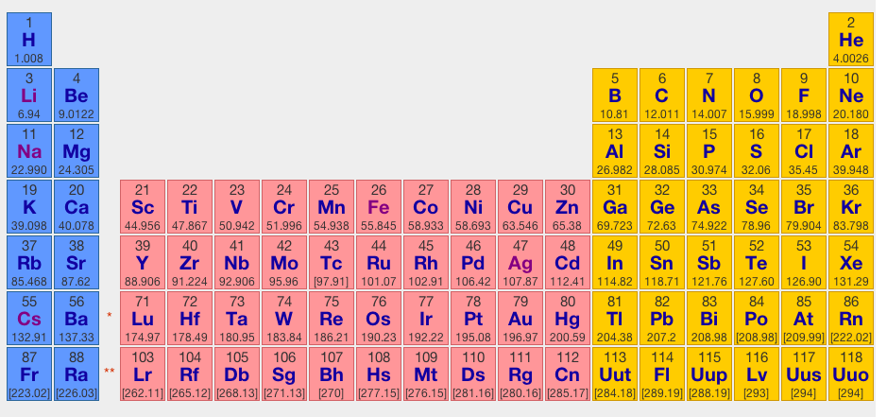
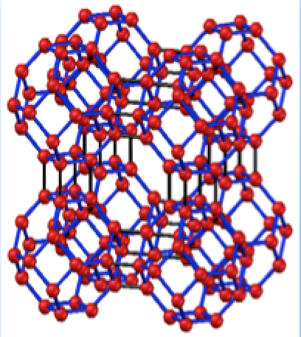
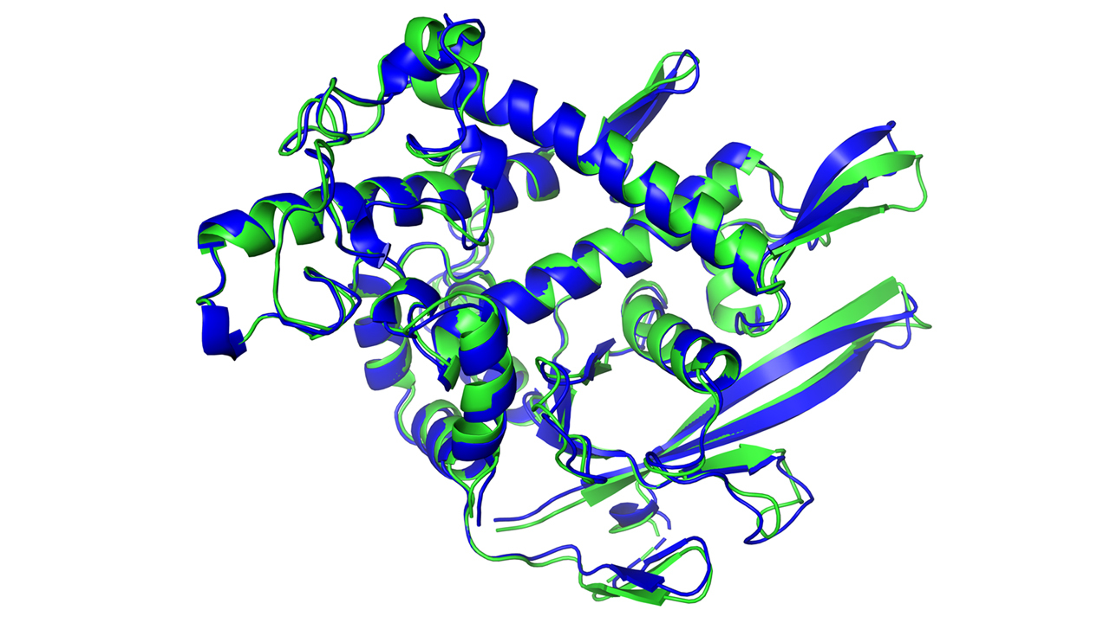
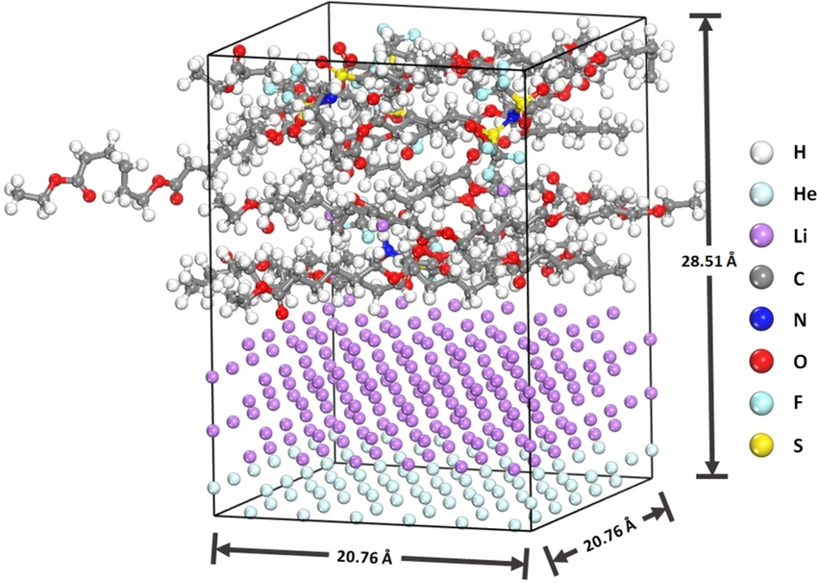
How about chemistry?
… to chemistry
Elements
100+
3D, infinite
configuration space
Structures
Rules
Quantum mechanics (subtle and hard to learn)

Slide 16

(ACE)
Atomic Cluster Expansion:
A Traditional ML Approach
Kovacs et al. J. Chem. Theory Comput. (2021)

Slide 17
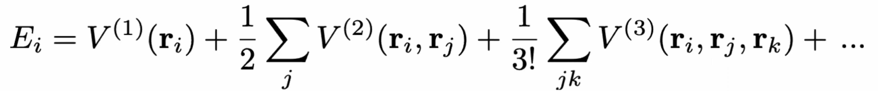
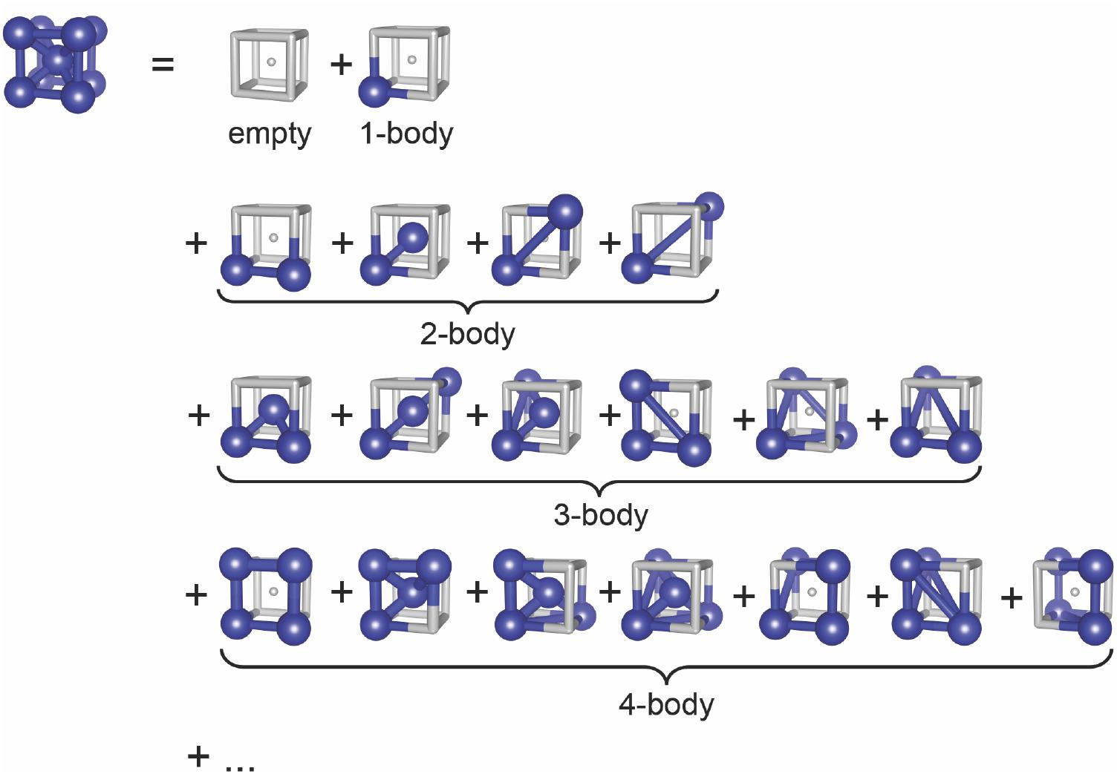
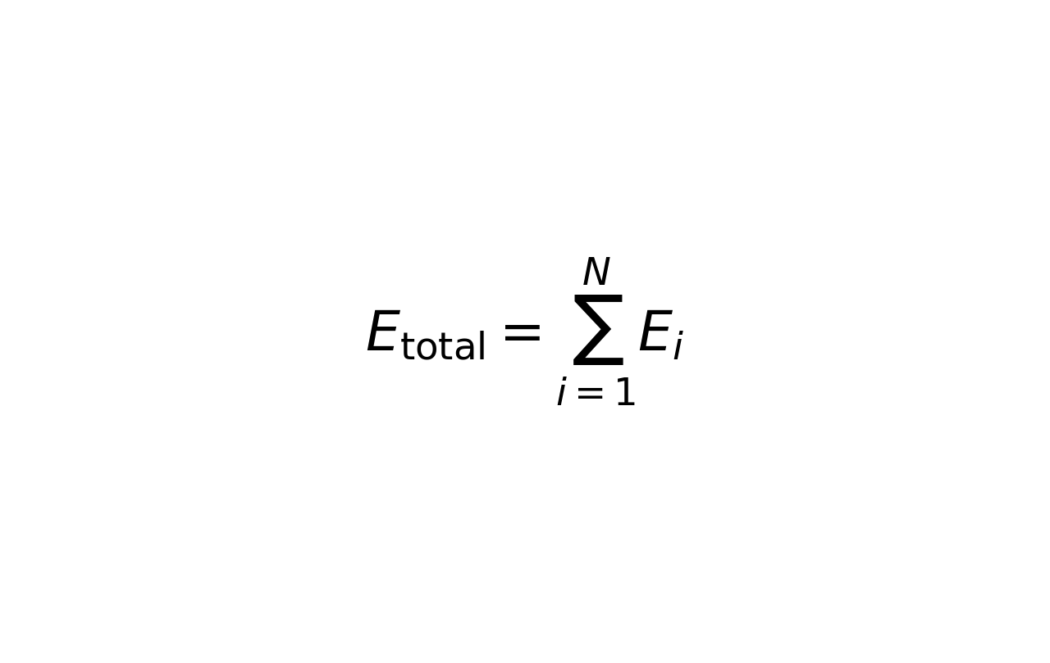
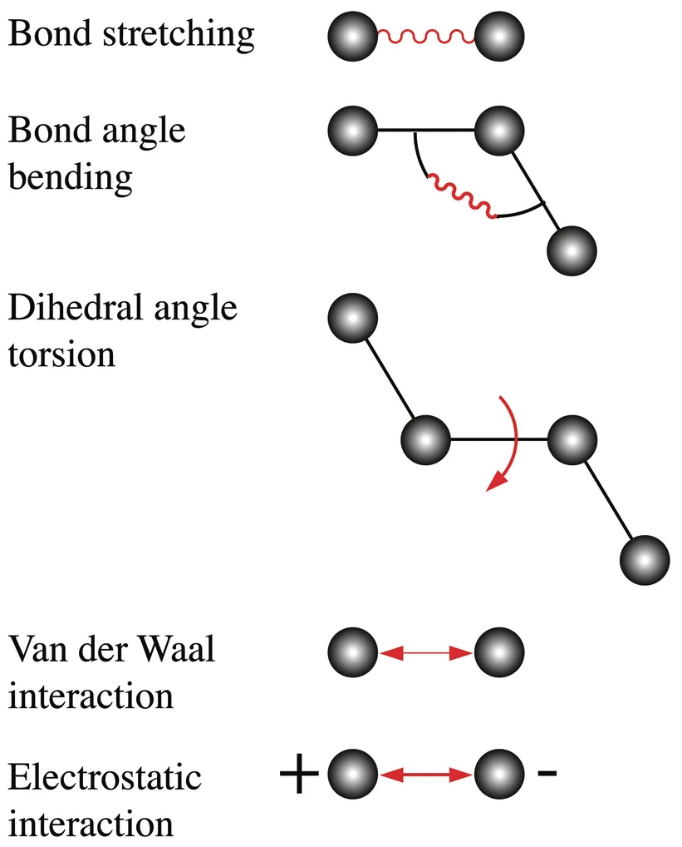
Cluster Expansion:
ACE representation
E_{total}=𝚺_{i}V⁽¹⁾(r_{i}) + 𝚺_{ij}V⁽²⁾(r_{i},r_{j}) + 𝚺_{ijk}V⁽³⁾(r_{i},r_{j},r_{k}) + …
Example: BCC Lattice
(r_{i},r_{j})
(r_{i},r_{j},r_{k})
(r_{i},r_{j},r_{k},r_{l})
Aziz et al. TOP APPL PHYS (2024)

Slide 18
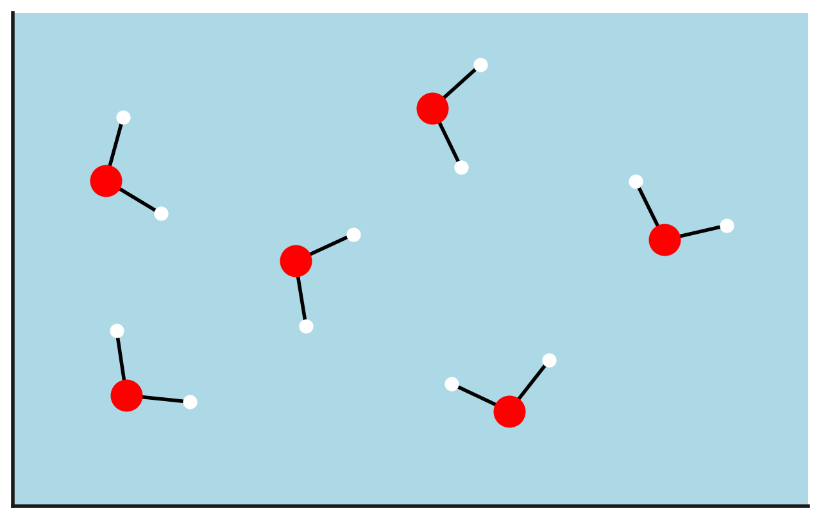
ACE for molecular systems
E₁₂
Total energy decomposes into site energies E_{i}
E₁
E₁₀
E₁₆
E₂
E₁₁
E₉
E₃
E₁₈
E₇
E₁₇
By summing all the energy values at each site, we find the total energy of our system
What is our site energy?
E₄
E₈
E₁₅
E₁₃
E₅
E₆
E₁₄

Slide 19
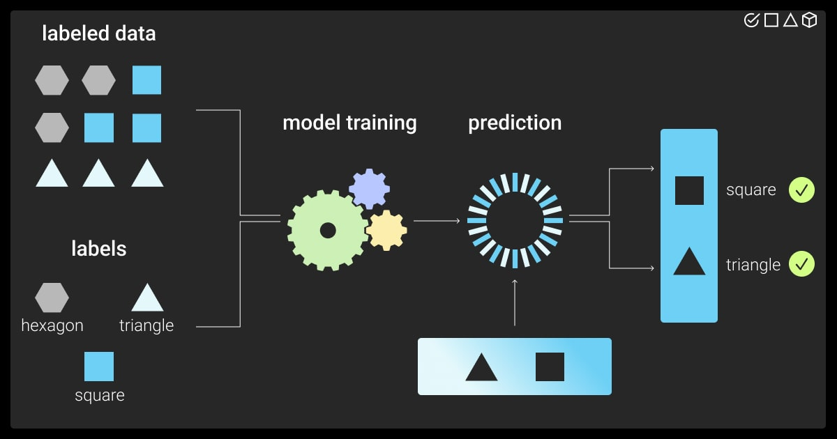
“Traditional” Machine Learning
Chemical
features
Predicted properties
We need to think about the system we are working with and determine what terms are most relevant to its behavior
Extracted data will vary based on whether we are predicting the behavior of a:
Protein
2D material
Battery
New compounds

Slide 20
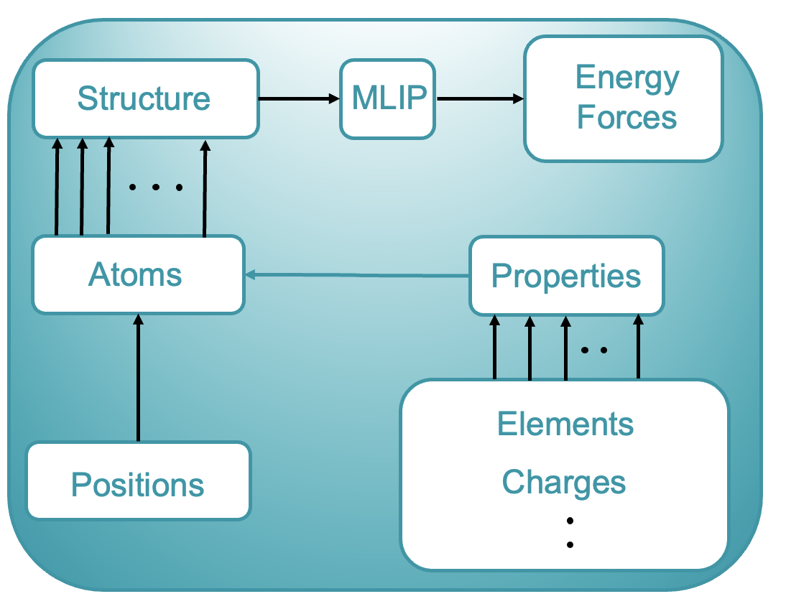

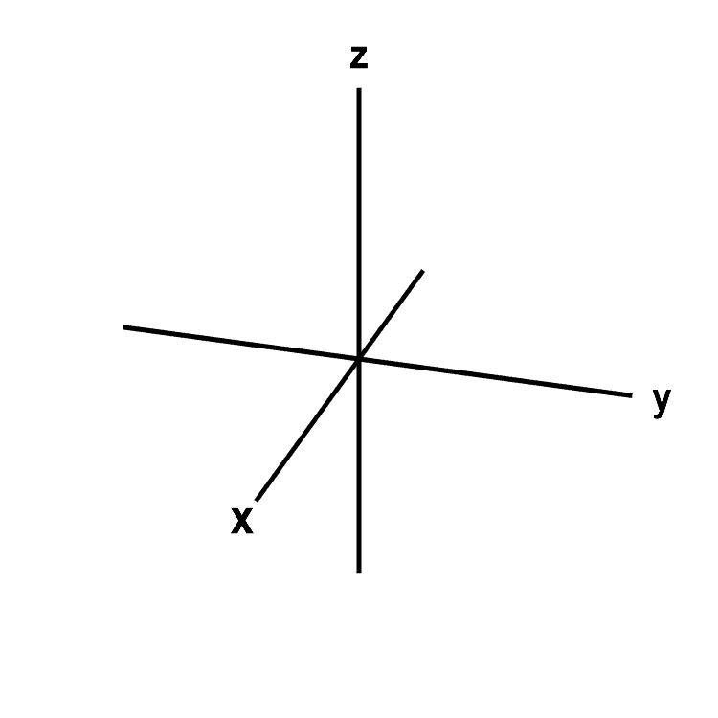
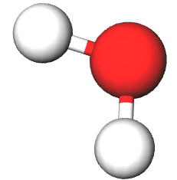

Representing Chemical Structures
A complex example…
Element: 8
Charge: -2
Electronegativity: 3.5
Position: (0,0,0)
etc.
Oxygen

Slide 21

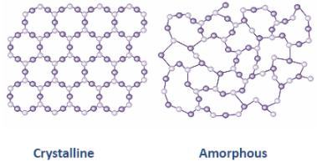
ACE Training and Predictions
Atomic Configuration
We need data:
Forces
Gathered from experiment and calculation
Energy
Chosen features/descriptors

Slide 22
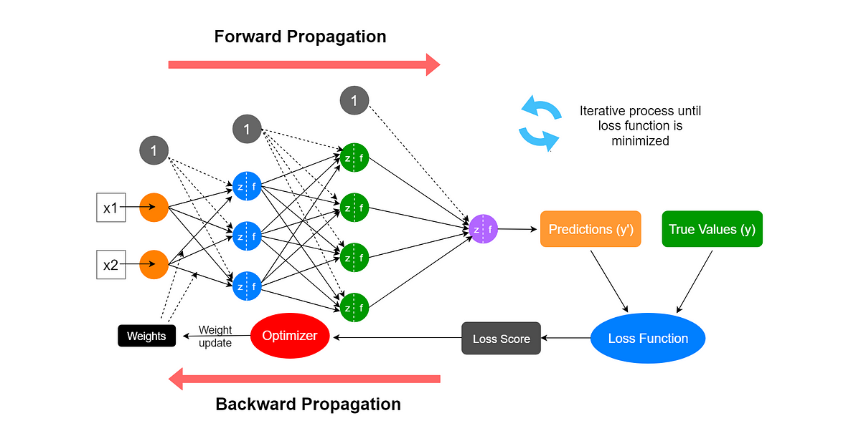
Anatomy of a Neural Network

Slide 23
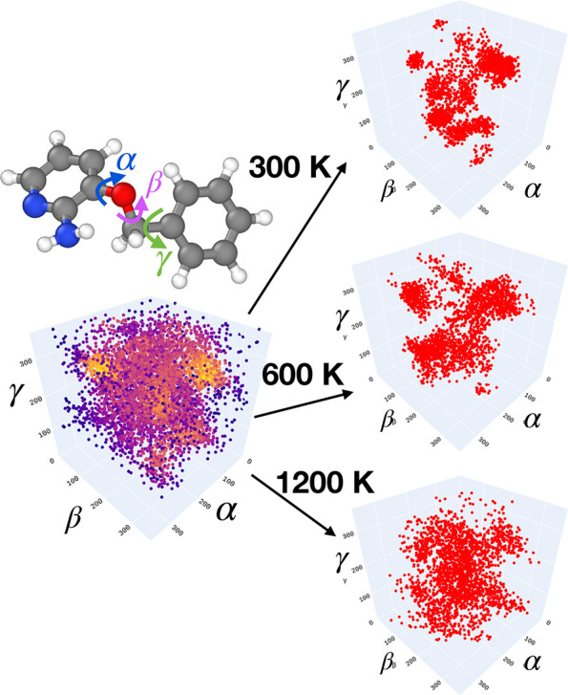
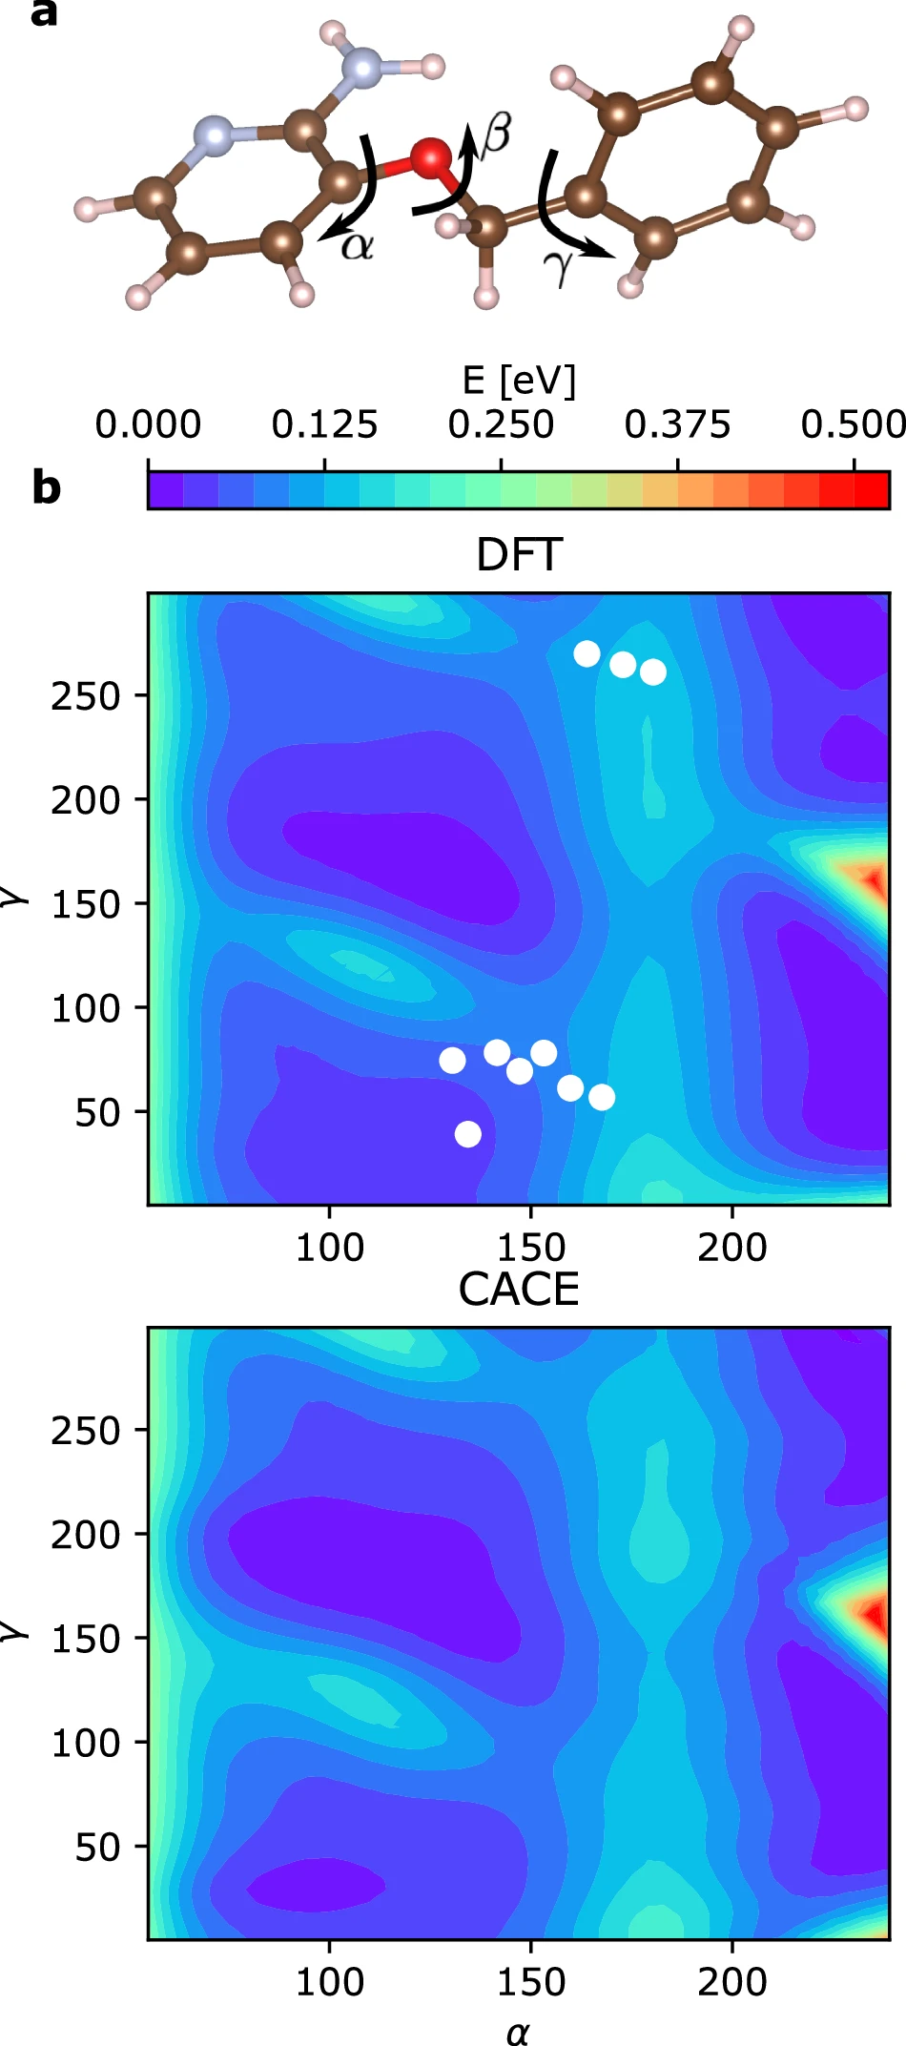



Potential Energy Surface Prediction
ACE applications in chemistry
β = 120°
Complex Dihedral Interactions
DFT
ACE
Cheng npj. Comput. Mater. (2024)

Slide 24
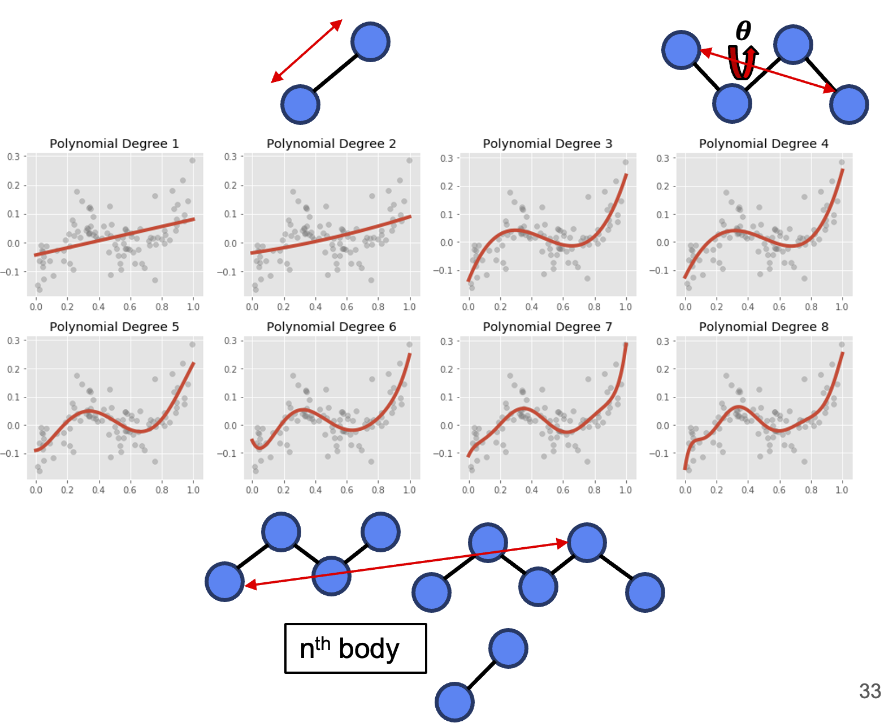

How does it work?
Essentially a polynomial-based approach that efficiently incorporates higher-order many-atom interactions
𝝉

Slide 25
ACE Success and Limitations
ACE is a polynomial-based approach used to describe the symmetry and many-body interactions of a system that can learn to map features to properties
However….
Problems with predicting properties of overly large or particularly complex systems
Accuracy tends to drop off after three chemical species
How do we improve our model?

Slide 26
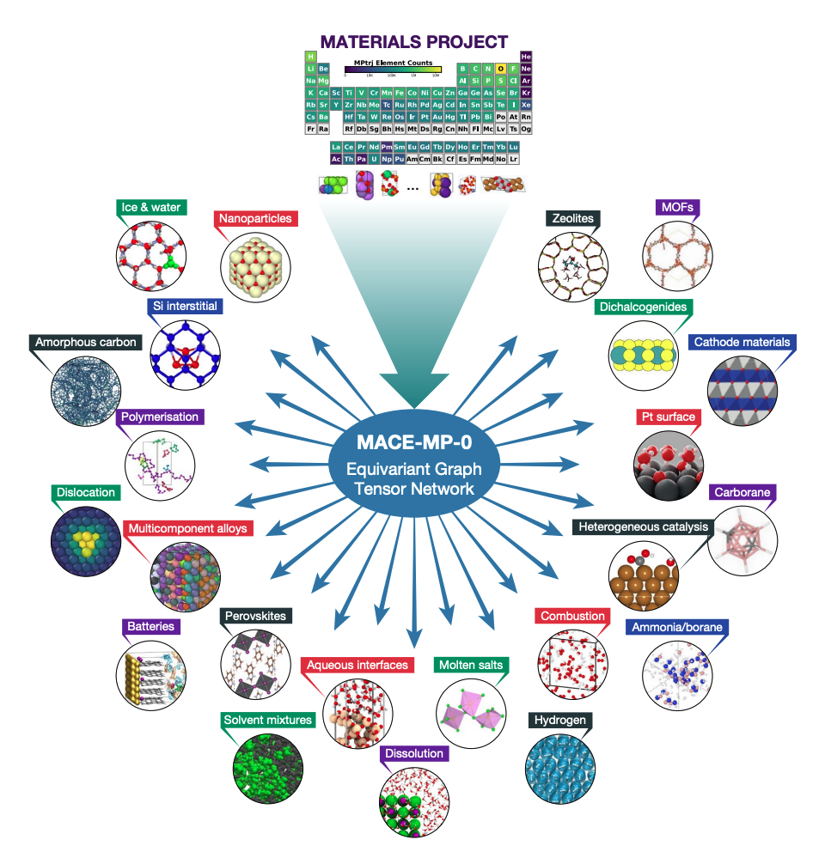
Message-passing Atomic Cluster Expansion:
A Deep Learning Approach
MACE
Batatia et al. arXiv (2024)

Slide 27
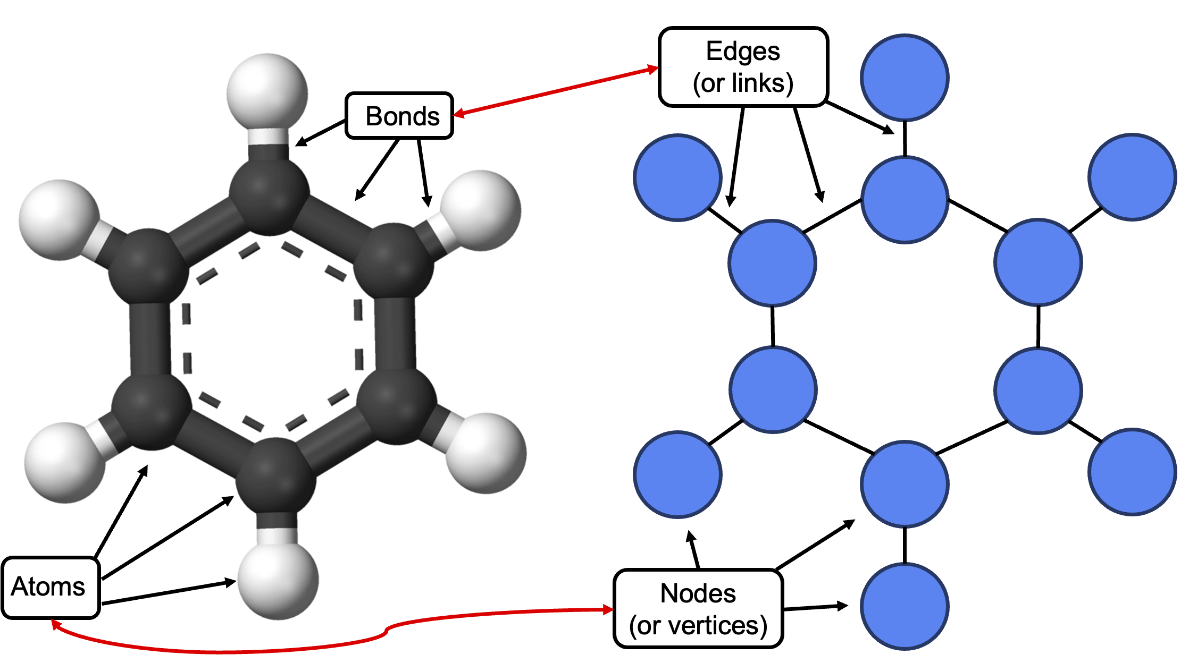
From molecule to graph

Slide 28
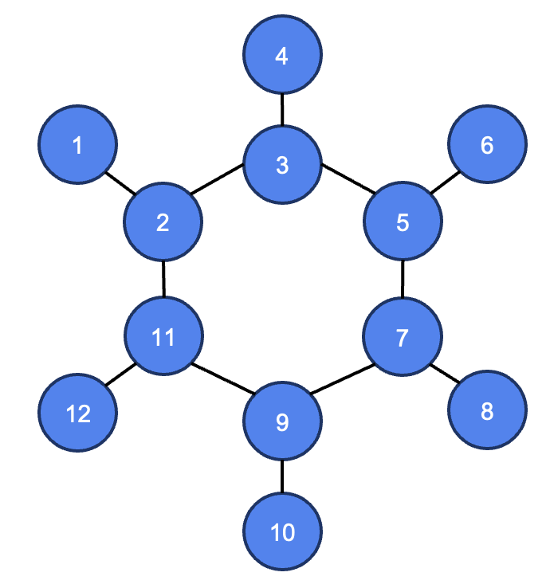
Encoding atom adjacency
Adjacency Matrix
0 | 1 | 0 | 0 | 0 | 0 | 0 | 0 | 0 | 0 | 0 | 0
1 | 0 | 1 | 0 | 0 | 0 | 0 | 0 | 0 | 0 | 1 | 0
0 | 1 | 0 | 1 | 0 | 1 | 0 | 0 | 0 | 0 | 0 | 0
0 | 0 | 1 | 0 | 0 | 0 | 0 | 0 | 0 | 0 | 0 | 0
0 | 0 | 1 | 0 | 0 | 1 | 1 | 0 | 0 | 0 | 0 | 0
0 | 0 | 0 | 0 | 1 | 0 | 0 | 0 | 0 | 0 | 0 | 0
0 | 0 | 0 | 0 | 1 | 0 | 0 | 1 | 1 | 0 | 0 | 0
0 | 0 | 0 | 0 | 0 | 0 | 1 | 0 | 0 | 0 | 0 | 0
0 | 0 | 0 | 0 | 0 | 0 | 1 | 0 | 0 | 1 | 1 | 0
0 | 0 | 0 | 0 | 0 | 0 | 0 | 0 | 1 | 0 | 0 | 0
0 | 1 | 0 | 0 | 0 | 0 | 0 | 0 | 1 | 0 | 0 | 1
0 | 0 | 0 | 0 | 0 | 0 | 0 | 0 | 0 | 0 | 0 | 1

Slide 29

How to represent atoms
State: each node i in layer t state 𝞼_{i}^{(t)} is defined on each atom by three quantities:
𝞼_{i}^{(t)} = (r_{i},z_{i},h_{i}^{(t)})
Position: r_{i}
Species: z_{i}
Learnable features: h_{i}^{(t)}
t: layer
x
y
z_{i}
z
h_{i}^{(t)}
Vector
Dimension ${\text{ℝ}}^{d}$

Slide 30
Graph propagation across layers
Input
L1
L2
Prediction

Slide 31
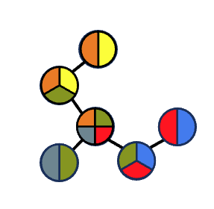


Information propagation across layers
A neural network learns function u to optimally modify messages between nodes

Slide 32



Site predictions
After final message is passed,
we can take our final node embeddings…
Output and sum all the site energies!
Pass them into a final neural network…

Slide 33



MACE applications in chemistry
Transition Metal Dichalcogenides
Hydrogen under pressure
Background
Current Limitations
MACE vs AIMD Analysis
Rosen et al. J. Phys. Chem. C (2018)
Monacelli et al. Nature (2023)

Slide 34



Transition metal dichalcogenides
2D materials made of transition metals and chalcogens
Applied in electronics, photonics, catalysis, sensors, and energy-storage applications.
Important structural features that modify properties
1) Edges (zigzag, armchair)
              2) Defects (vacancies, substitutions)
Optical properties and exciton behavior are influenced by edges and defects
Qi et al. J. Appl. Phys. (2013)

Slide 35


Edge structure prediction by MACE
${\text{θ}}_{s}=$ the sulfur coverage
Multi-layer model with infinite stripes
Both Mo and S edges largely retain the structural features predicted by DFT
Exception of sulfur dimer formation at sulfur edge with ${\text{θ}}_{s}$=1
Rosen et al. J. Phys. Chem. C (2018)

Slide 36

Defect formations in WS₂
Kieczka et al. IOP (2023)

Slide 37



Defect formation energies

Slide 38


The good, bad, and ugly
The ability of MACE to predict defect energy formation generally related to the size of the interstitial gap left by the defect relative to ideal lattice
Substitution of S₂ with W (large atom) yields a very accurate prediction
Larger W and W + S₃ vacancies result in poor predictions due to unique chemical environment of resulting interstitial sites

Slide 39


Hydrogen under high pressure
Ashcroft (1968): Predicts solid hydrogen to be a room temperature superconductor
Success of metal superhydrides has increased interest in H₂ under pressure
Difficult to simulate due to factors like anharmonicity and zero-point energy
Ashcroft PRL (1968)
Monacelli et al. Nature (2023)

Slide 40



Molecular dynamics: MACE versus DFT
Molecular fluid behavior (gas) behavior of hydrogen accurately predicted at low pressure
Model predicts formation of free moving rotors in phase I
Standard MACE model fails at 10 GPa simulation
Pickard et al. PRB (2012)
Cheng et al. Nature (2020)

Slide 41


MACE high pressure failure
MACE-stress model created to improve prediction of hydrogen at high pressure
Loss function modified to have a 10x multiplier on the stress error
Improves model prediction from 10 GPa but still fails at 60 GPa via formation of non-physical hydrogen chains

Slide 42





Summary and Outlook
+
MLIPs deliver high accuracy and computational efficiency, robustly predicting chemistry across diverse chemical and physical environments
Accuracy dramatically goes down when applied to systems drastically different from training data

Slide 43




Acknowledgements
Dr. Maosheng Miao
Dr. Abhiyan Pandit
Samantha Scott

Slide 44
Questions?

Slide 45
Supplemental

Slide 46

Zero-point Energy
Lowest possible energy a quantum system can have
Even at 0 K, systems possess residual energy due to Heisenberg uncertainty principle

Slide 47





MPNN Interatomic Potentials

Slide 48




MACE Message Construction

Slide 49



Equivariant Graph Neural Networks

Slide 50

MACE Update and Readout

Slide 51

Anharmonicity

Slide 52

Anharmonicity cont.

Slide 53

Large systems into neural networks

Slide 54
Many-body interactions
Many different interactions can affect the energy at one “site” or atom
Direct neighbors have a large impact on local energy, but so can second and third neighbors

